Slide 1

Harnessing Computational Tools and Complex Biological Data for Environmental and Health Applications
Yunfei (Eric) Liao
April 22nd, 2024

Slide 2
Content
Introduction
01
Previous Work
02
Cx. Tarsalis Population Genetics
03
West Nile Virus Prediction
04

Slide 3
1. Introduction

Slide 4
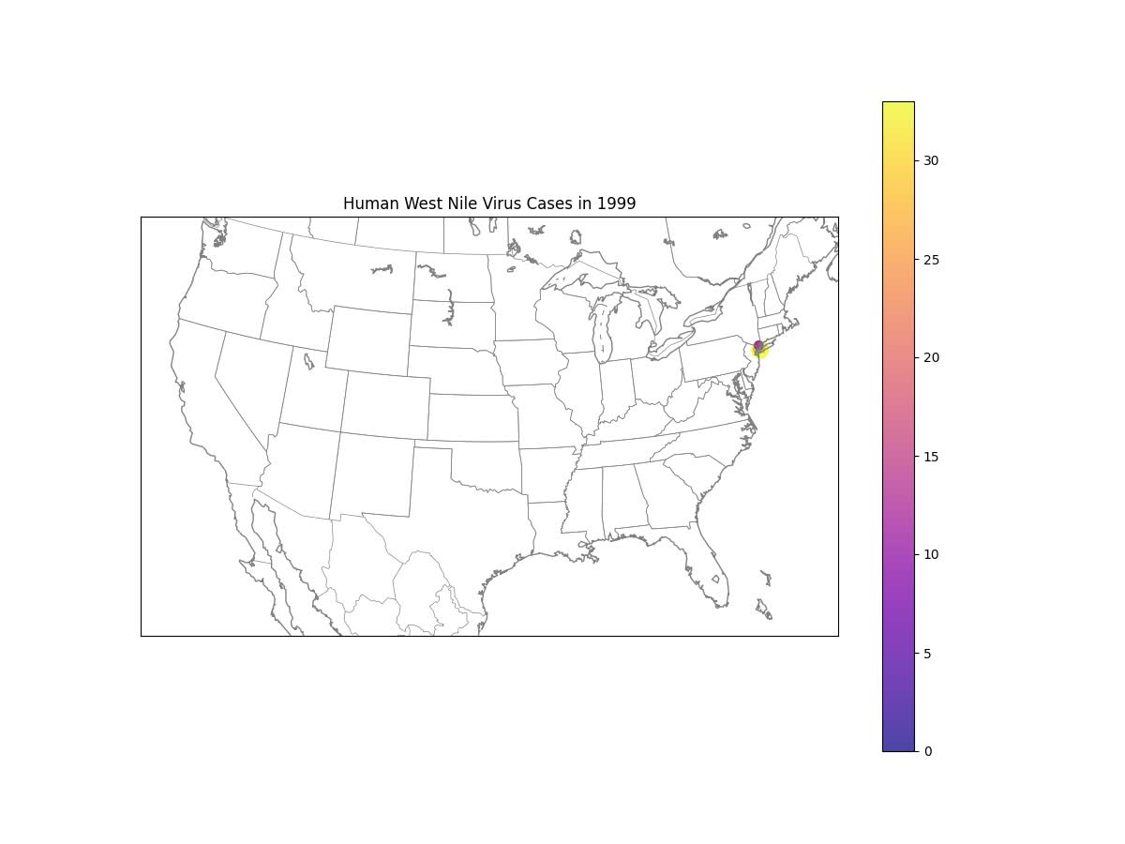
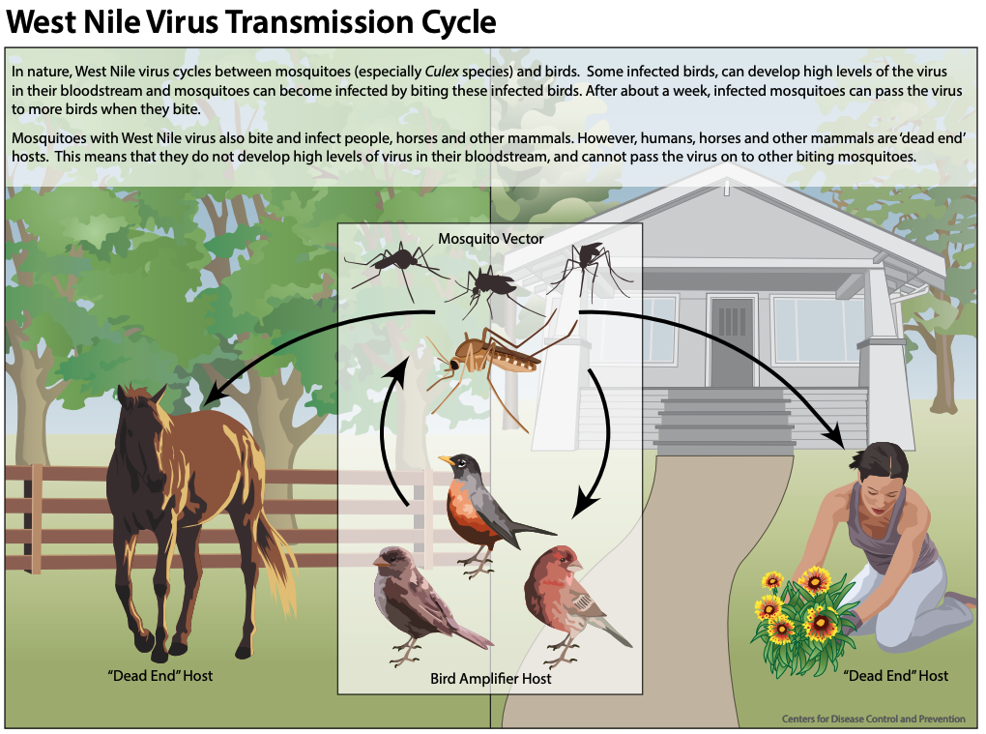
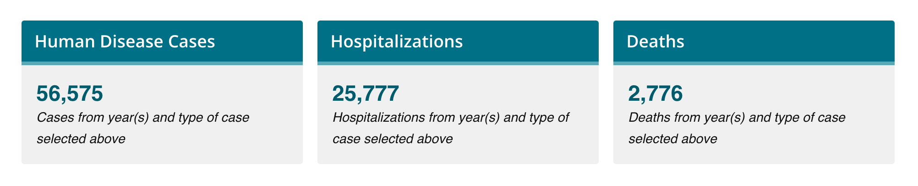
Background
West Nile Virus (WNV): A global health concern
Mosquito-borne, Culex tarsalis
Complex dynamics of transmission
Difficulty in prediction and control
* CDC stats
Notes:
WN virus was first isolated in the WN province of Uganda in 1937. Since then, it has been a global issue.
The first case detected in the United States in New York City in 1999. Since then, it has spread across the entire country within a few years. (show the video)
Here is the CDC's surveillance report by 2023, there are more than 56 thousands people reported had WNV and 2776 out of them are dead.
West Nile Virus is a mosquito-borne disease. It threats not just to human health, but also to wildlife and broader ecosystem.
The transmission of the West Nile Virus is quite complex. These interactions between virus, mosquitoes and environments keep changing because of things like weather changes, cities expanding, and people and birds moving around. This means we need to keep adapting our strategies to predict when the virus will spread.
Cx. tarsalis to Ct.
Note: how to narrotive the hypothesis and hypothesis is testing.
Amova test reference.

Slide 5






Innovation
Interdisciplinary Bioinformatics: Unraveling the complex interplay between environmental factors, vector biology, and pathogen dynamics to assist public health strategies.
Advanced Computational Tools: Dissecting the intricate influences on West Nile virus transmission, focusing on the subtleties beyond direct environmental and demographic impacts.
Broader Data Spectrum: Refining models with a comprehensive data approach to reveal critical, yet overlooked, aspects of disease ecology vital for combating vector-borne diseases.
Unveiling Hidden Patterns: Through the integration of diverse data, we aim to illuminate patterns previously unrecognized, significantly impacting health outcomes and prevention strategies.
Notes:
So the big question is: how can we use all the data and computer tools we have to better understand, predict, and finally get a handle on this health issue?
Right now, it's very important to come up with new ways and improve our tools to tackle the problems we’re facing.
This challenge is what shapes my research and pushes me to search for solutions that can adapt.

Slide 6
Aims
Aim 1: Identify genetic variations in Culex tarsalis, focusing on adaptations that may influence environmental resilience.
Aim 2: Develop a national-scale predictive model for West Nile virus transmission, integrating a wide range of data for improved early warning systems.
Aim 3: Establish a regional model for monthly WNV prediction at the county level, using detailed environmental and demographic data to aid localized public health efforts.

Slide 7
Adding a table of the publications

Slide 8

Approaches
Integrating computational biology
Studying mosquito genetics & environmental factors
Enhancing predictive models
Notes:
In response to the formidable challenges posed by the West Nile Virus, our approach is distinctly interdisciplinary, combining the precision of computational biology with the depth of traditional biological research.
Firstly, we delve into the world of computational biology, leveraging its power to manage and analyze vast datasets. This is where the digital meets the biological—through algorithms that sift through mass spectrometry data, genetic sequences, environmental variables, and clinical surveillance data to identify patterns and predictions that elude the naked eye or conventional analysis.
Simultaneously, we ground our research in the solid bedrock of molecular biology and genetics. By studying the Culex mosquito, the primary vector for the West Nile Virus, we uncover genetic variations and adaptations that enable its survival and efficiency in expanding. This biological insight is crucial; it provides the context and the variables that potentially feed into our computational models.
Together, these disciplines allow us to enhance our predictive models in ways previously unimaginable. We're not just predicting the when and where of West Nile Virus outbreaks but also understanding the how and why—insights that are vital for developing effective public health strategies and interventions.
Our interdisciplinary approach is a bridge between two worlds, harnessing the strengths of each to forge a comprehensive understanding of and response to the West Nile Virus. It's through this fusion of computational power and biological insight that we can aspire to outpace, outsmart, and ultimately overcome the challenges posed by this persistent public health threat.

Slide 9
2. Previous Work

Slide 10
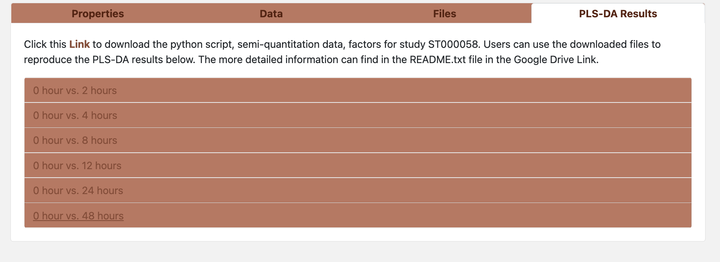
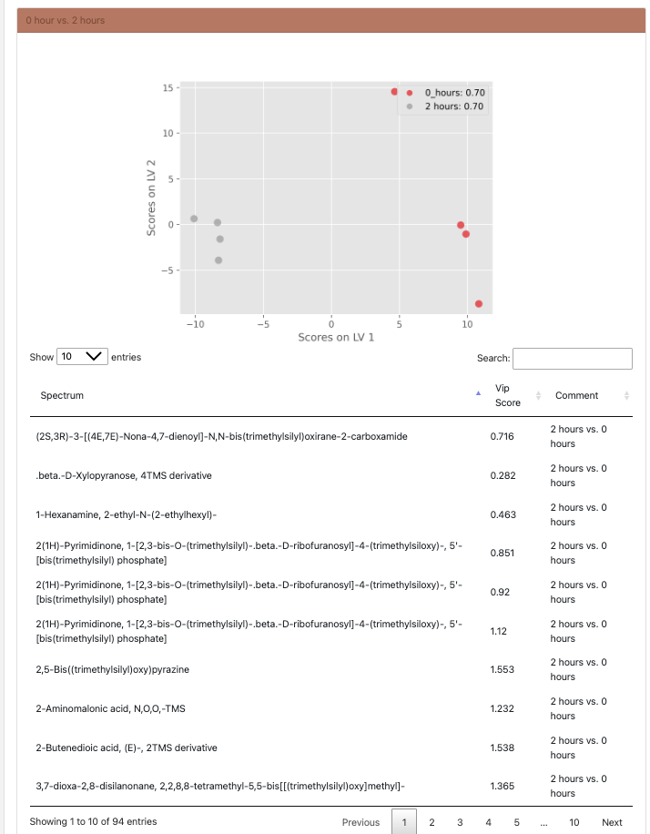
ADAP-KDB and Metabolic Signature Discovery
Publications:
Liao, Y., Smirnov, A. & Du, X. (2022). Memory-Efficient Searching of Gas-Chromatography Mass Spectra Accelerated by Prescreening. Metabolites, 12(6), 491.
Smirnov, A., Liao, Y., Fahy, E., Subramaniam, S., & Du, X. (2021). ADAP-KDB: a spectral knowledgebase for tracking and prioritizing unknown GC–MS spectra in the NIH’s metabolomics data repository. Analytical Chemistry, 93(36), 12213-12220.

Slide 11
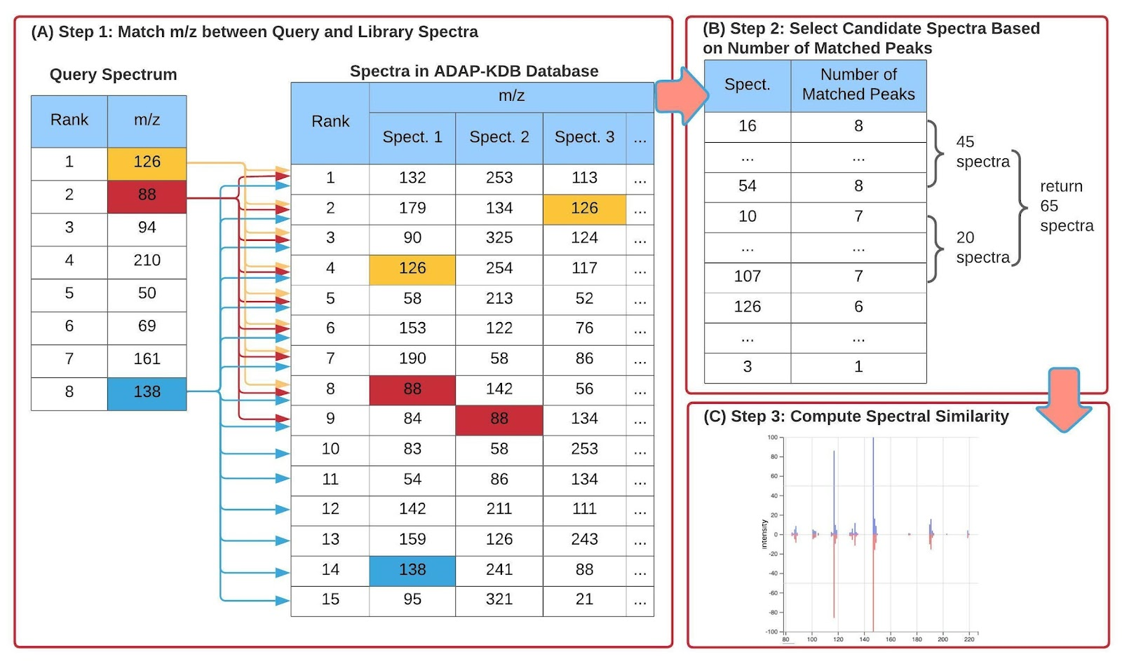
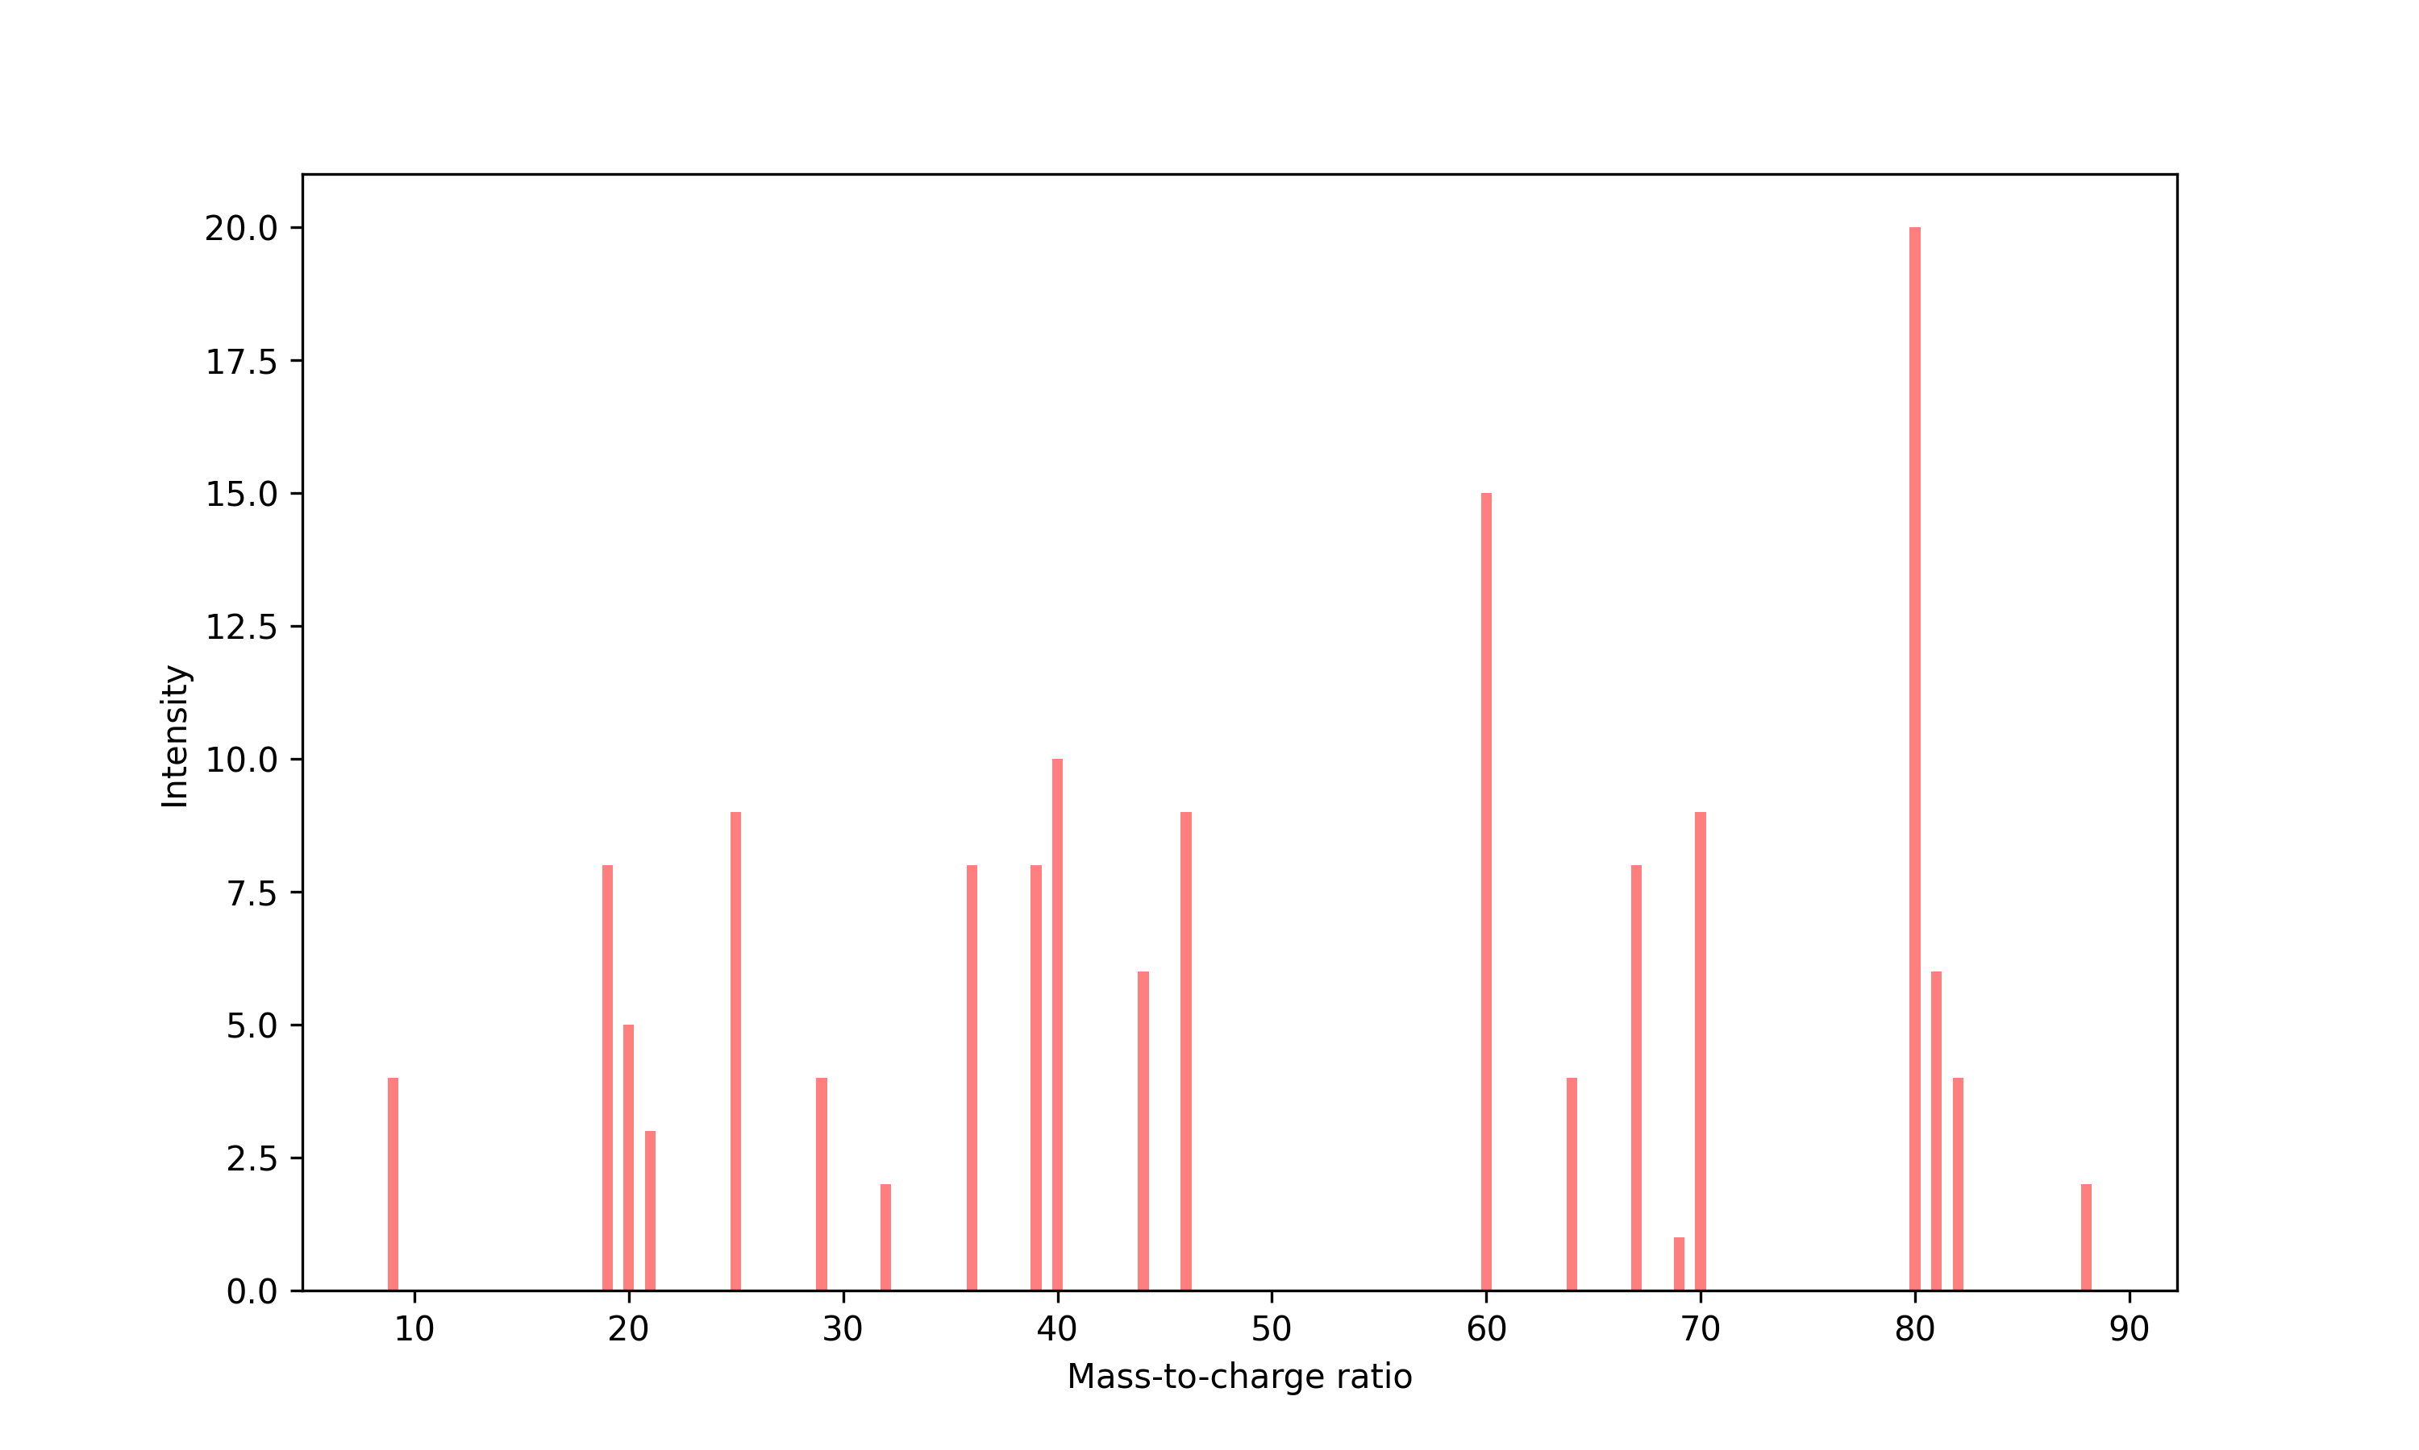
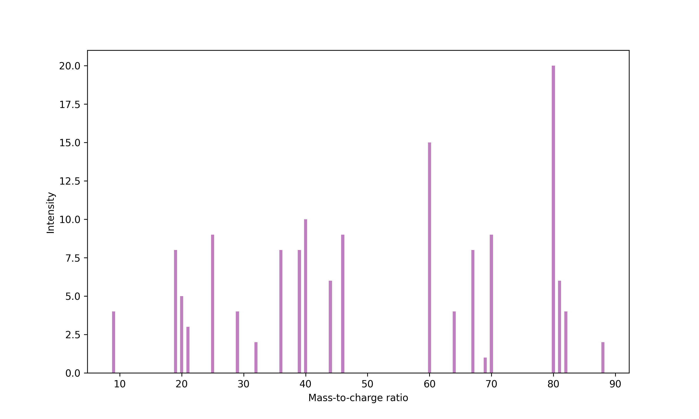
I. ADAP-KDB Prescreening Algorithm
Original algorithm
New algorithm
User Spectra
Database Spectra
…. The Rest of Spectra
Notes:
Automated Data Analysis Pipeline Spectral Knowledgebase (ADAP-KDB) . it allows for the comparison and identification of unknown mass spectra against a database of known compounds
The previous algorithm calculated the similarity score by comparing each peak in a user's spectrum to every peak in each database spectrum, after calculating all the similarity score, on the peaks with a closely matching mass-to-charge ratio (m/z). As the size of the database grew, the time required for these comparisons increased significantly, making the process less efficient.
In the new algorithm , before we calculate the similarity between each pair spectra, we implemented a pre-screening methods to filter out the spectra in the database which have low likelihood to be a match. In this prescreening, we choose a cutoff with number of matched peaks to choose potential candidates to use to calculate the similarity score between database candidate spectra and user spectra. In this way, we reduce the computational workload from thousands spectra to just a few dozens database spcetra

Slide 12
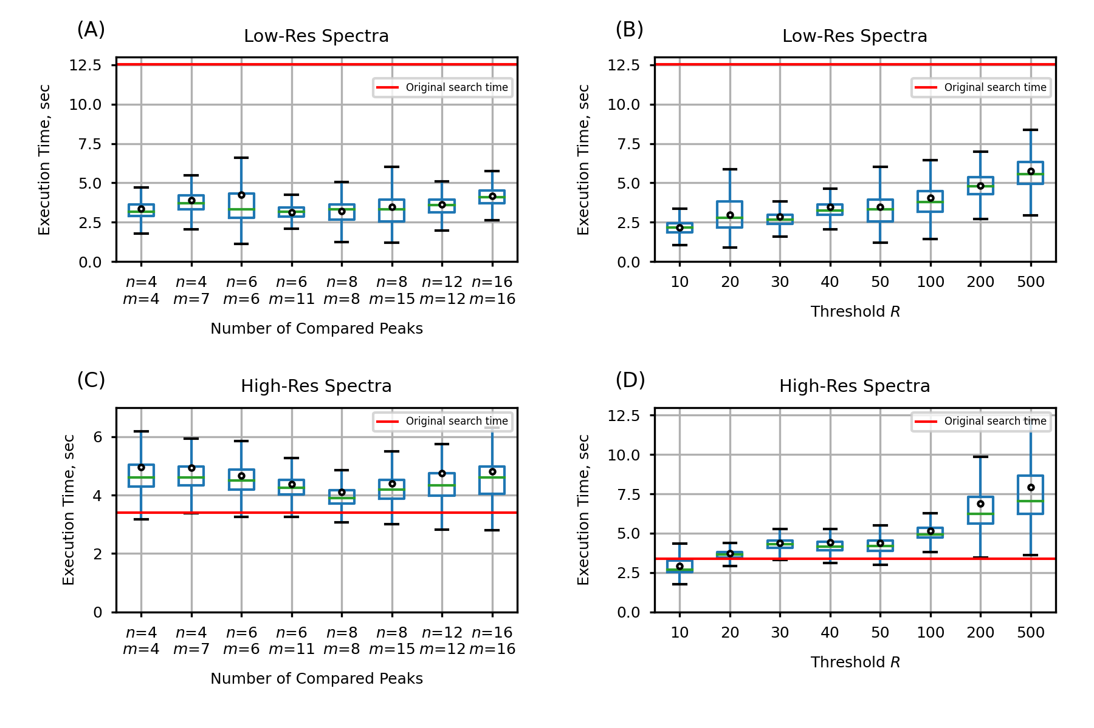
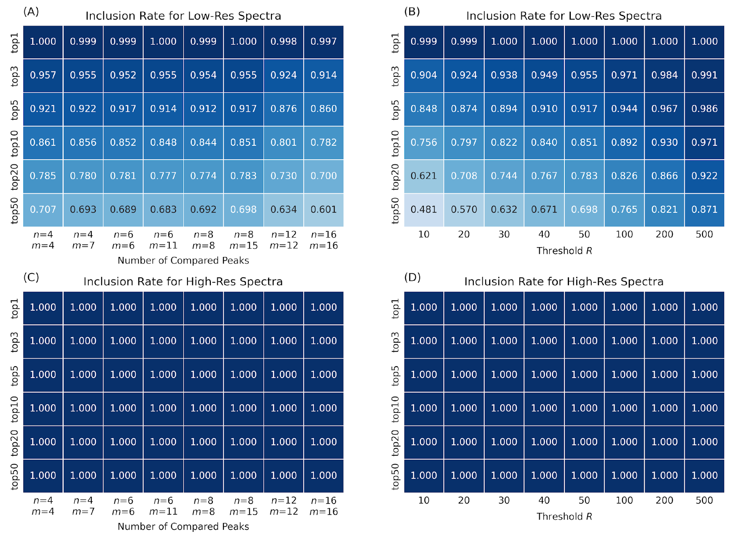
ADAP-KDB Prescreening Results
Figure 1. Execution times of the new search algorithm
Figure 2. inclusion rates of the new search algorithm
** Estimated for prescreening parameters (𝑛,𝑚,𝑅), where n is the number of query spectrum peaks participating in the prescreening search, m the number of library spectrum peaks participating in the prescreening search, and R determines the number of candidate spectra returned by the prescreening search: (A,B) search against low-resolution spectra; (C,D) search against high-resolution spectra.
Notes:
Performance of the execution time is significantly improved for the low-resolution spectra search,
Additionally, we check the effectiveness of our pre-screening algorithm by seeing how many of the best matches, are still identified after we apply this initial filtering. (based on a specific score threshold (similarity score greater than 0.6)
In simpler terms, we make sure that our method is not just faster but still accurate by comparing it to the results from the more time-consuming original search. We can see the inclusion rate are generally very high.

Slide 13
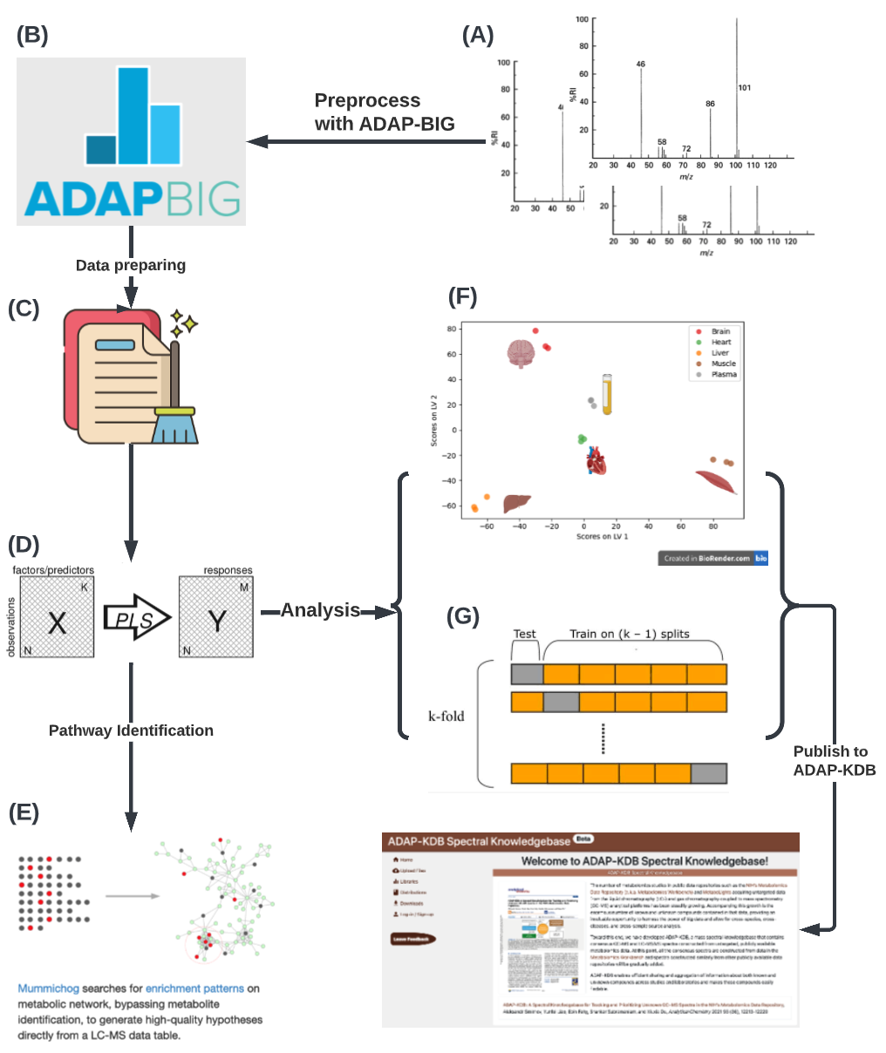
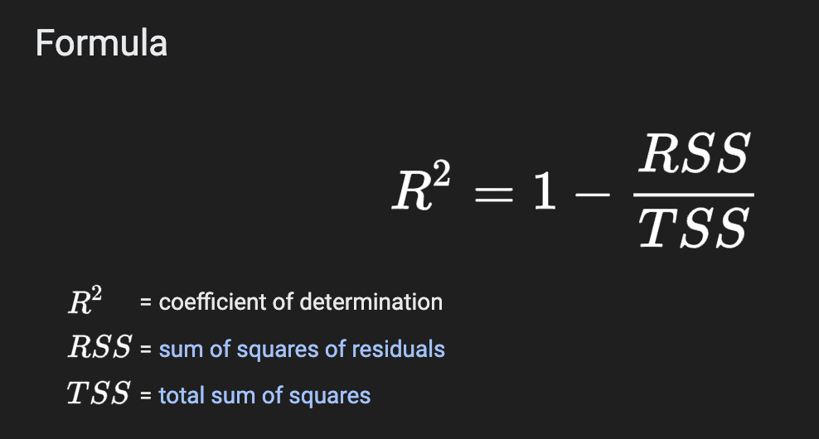
II. Metabolic Signature Workflow
Preprocessing metabolomics data
Partial Least Squares Discriminant analysis (PLS-DA)
Calculating Variable Influence on Projection (VIP) score
Cross validation (LOOCV) & Q²
Publishing visualization and metabolic signature results on ADAP-KDB
Notes:
Partial Least Squares Discriminant Analysis (PLS-DA) is a supervised multivariate statistical method used to find the relationship between two matrices (X and Y
Essentially, it's like a detective method that helps uncover the most important variables that can separate or classify different groups (like healthy vs. diseased) in a set of data. It's often used in fields like chemometrics and metabolomics.
A VIP score is a measure of a variable‘s importance in the PLS-DA model. It summarizes the contribution a variable makes to the model. VIP scores equals to 1 means the variable is contributing to the model precisely at the average level of contribution of all variables, metabolites have VIP scores significantly greater than 1 are often considered important for the model's predictive ability,
Leave-one-out cross validation for small samples size.
Q2 is to use how well the predictive power of the model with unseen data.
R2 measures how well the model can predict the outcomes it was trained on.
Q2, on the other hand, measures how well the model can predict new, unseen outcomes
R2 is like checking how well a student can solve problems they studied in a homework assignment
Q2 is like checking how well the student can solve new problems on an exam, based on what they learned from the homework.
R2 = 1 – RSS/TSS = 1 – sum(yi – y_hat)2 / sum(yi – y_bar)2
yi – actual y value
Y_hat – predicted y value
Y_bar – mean of actual y values
RSS=sum of squares of residuals
TSS=total sum of squares
How VIP is calculated: The VIP score of a variable is calculated as a weighted sum of the squared correlations between the PLS-DA components and the original variable.

Slide 14
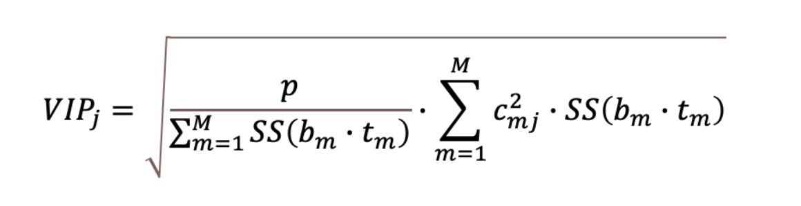
Variable Influence on Projection (VIP)
VIP is a weighted sum of squares of the PLS weights, c*, taking into account the amount of explained Y-variance in each dimension.
The VIP score for the variable j is defined as:
Where p is the number of variables, M the number of retained latent variables, c_{mj} the PLS
weight of the j-th variable for the m-th latent variables and SS(bm · tm) is the percentage
of y explained by the m-th latent variable. b is the regression coefficient vector.

Slide 15
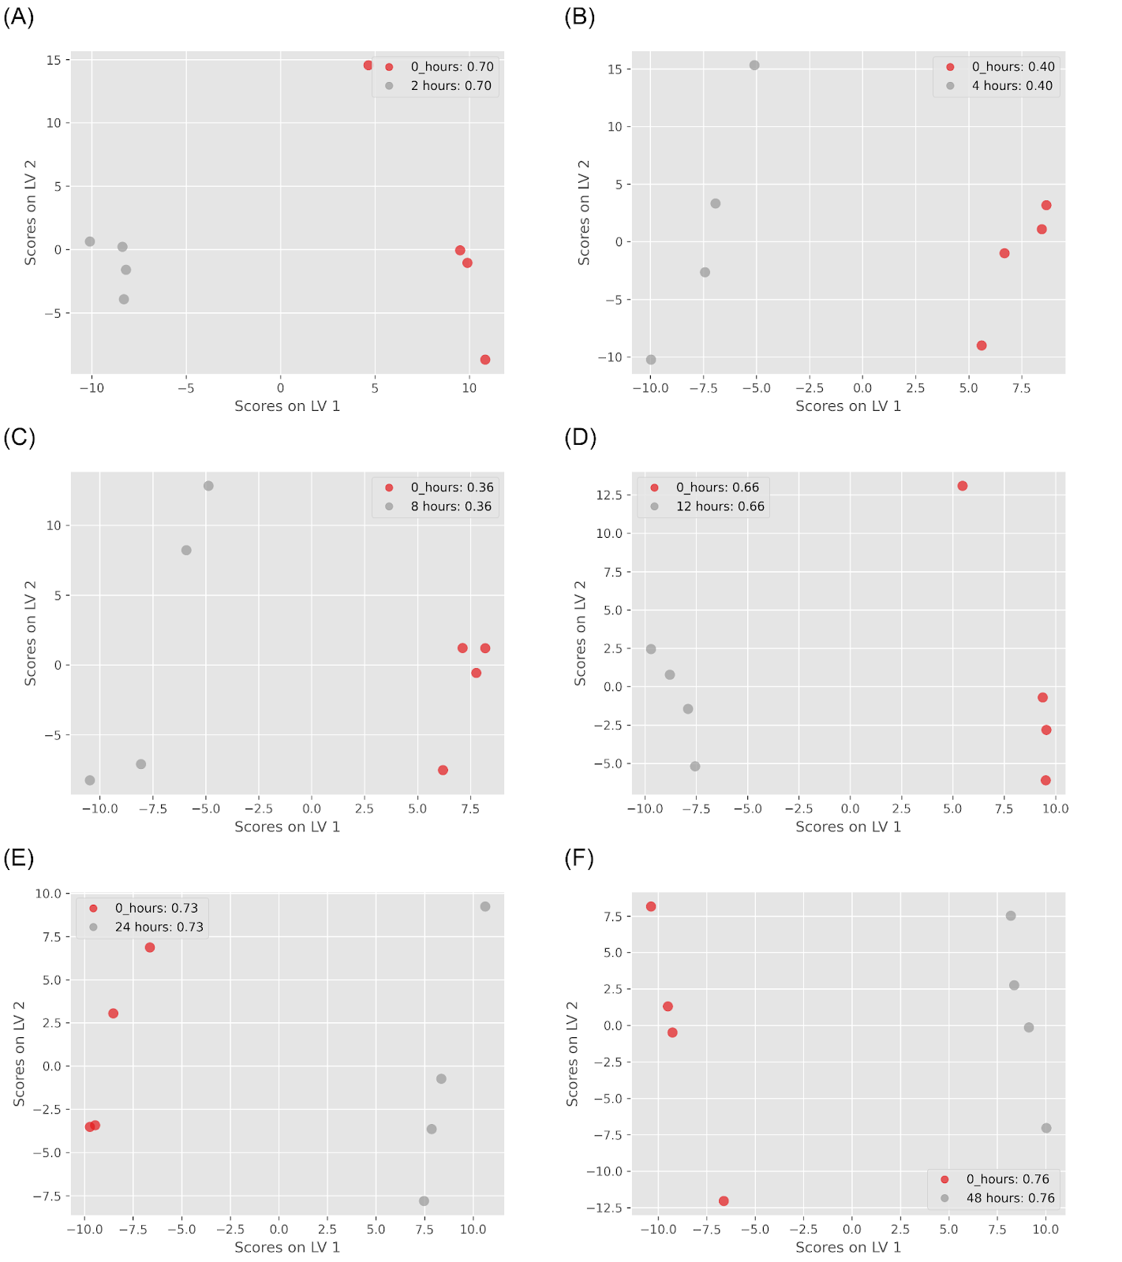
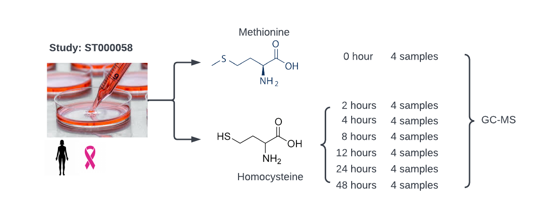
Metabolic Signature Work - Example
ST000058 from Metabolomics Workbench:
GC-MS
Metabolite changes associated with methionine stress sensitivity of cancer
Figure ST000085 PLS-DA results: (A) control group vs. 2 hours treatment group (Q²=0.7); (B) control group vs. 4 hours treatment group (Q²=0.4); (C) control group vs. 8 hours treatment group (Q²=0.36); (D) control group vs. 12 hours treatment group (Q²=0.66); (E) control group vs. 24 hours treatment group (Q²=0.73); (F) control group vs. 48 hours treatment group (Q²=0.76);

Slide 16
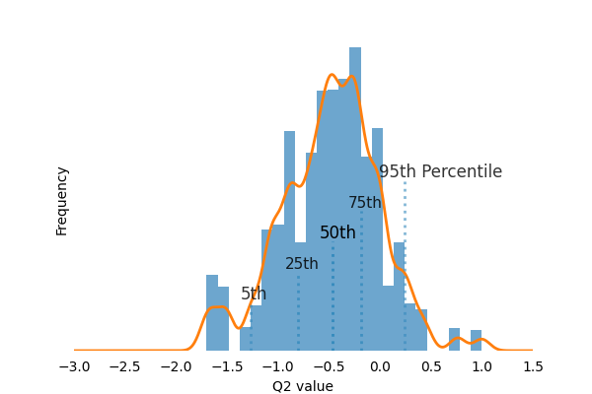
Permutation Test on Control Group and Group 7 (48 hours)
Figure: Permutation test on control group (1) and 48 hours treatment group (7) with 10,000 iterations

Slide 17
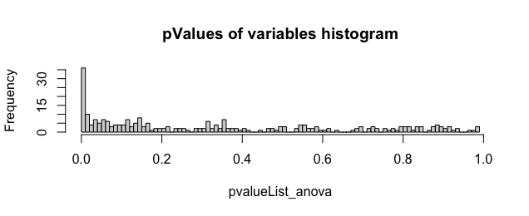
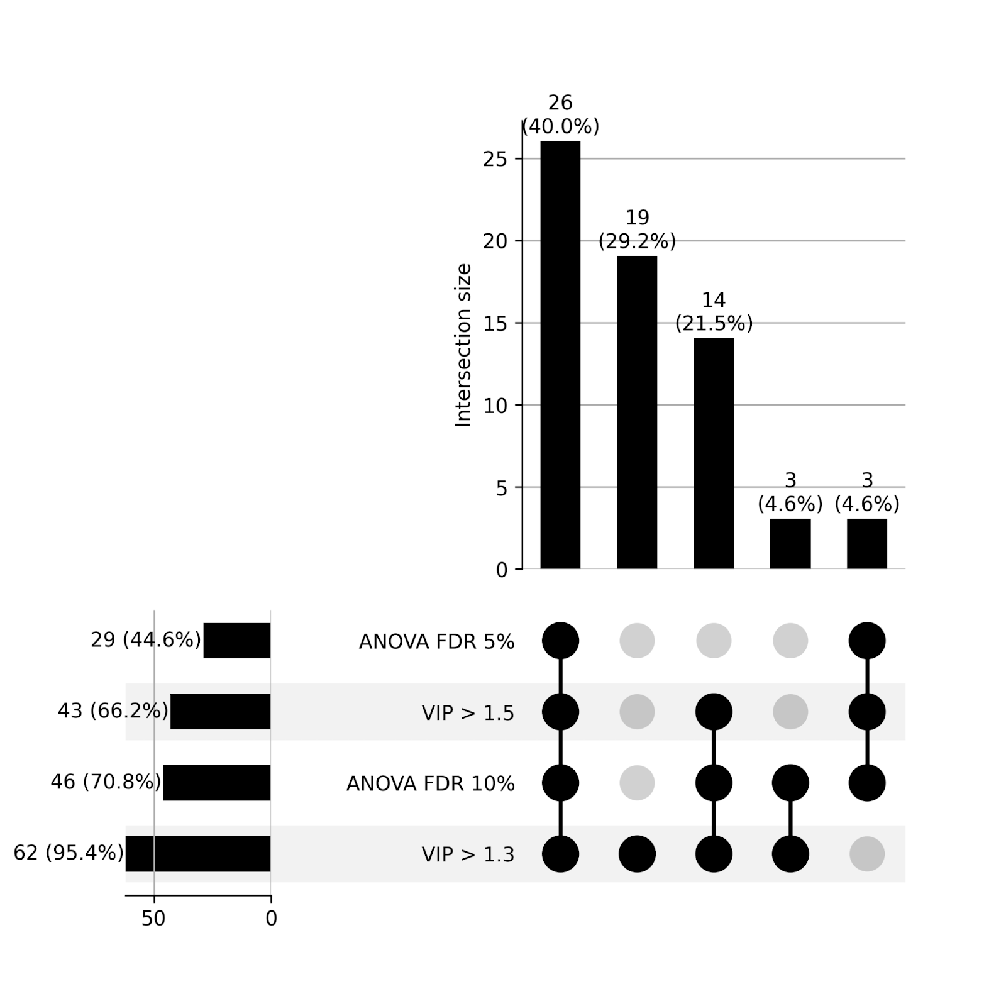
ANOVA Test on Group 1 and Group 7
Figure: Histogram of metabolites’ P-values from ANOVA test
At 5% false discovery rate, the number of significant variables is 26.
At 10% false discovery rate, the number of significant variables is 43.
# Compared to PLS-DA using VIP score:
With VIP score threshold >1.0, there are 117 variables
With VIP score threshold > 1.3, there are 62 variables
With VIP score threshold >1.5, there are 43 variables
Figure: Upset plot between PLS-DA and ANOVA test. VIP cutoff is 1.3 and 1.5 in PLSDA; FDR threshold is 5% and 10% in ANOVA test.
Notes:
VIP scores and get a score of 1, it means the variable is contributing to the model precisely at the average level of contribution of all variables

Slide 18
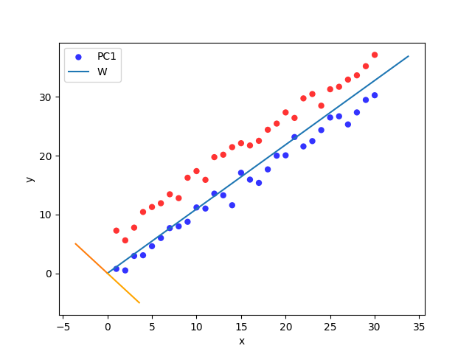
Why NOT Univariate Statistics
High Dimensionality
Collinearity (Right Figure )
Overfitting and False Discovery
Collinearity Example
Notes:
High Dimensionality: Metabolomics datasets often have a high number of features (metabolites) compared to the number of samples. This high dimensionality can lead to challenges when using univariate methods because they analyze each feature independently, potentially missing important interactions or patterns among metabolites.
Collinearity: Metabolites in biological systems are often correlated or collinear, meaning that the levels of one metabolite may be related to the levels of another. Univariate methods like ANOVA do not account for these relationships between metabolites, potentially leading to false positive or misleading results.
Multivariate Nature of Biological Systems: Biological systems are inherently multivariate, meaning that multiple variables (metabolites) are involved and interact with each other to produce a phenotype. Univariate methods do not capture these complex interactions.
Overfitting and False Discovery: Univariate methods applied to high-dimensional data are susceptible to overfitting, where the model captures noise in the data rather than true underlying patterns. This can lead to false discovery of significant features.

Slide 19
3.Cx. Tarsalis Population Genetics

Slide 20
Workflow
ADMIXTURE
Sample Collection
Population Structure Analysis
AMOVA
SIFT
IBD & IBE
Genome Sequencing, Assembly, and Annotation
Genotype-Environment Association
Common Genes
LFMM
RDA
Mapping and Annotating Candidate SNPs to Functional Gene
RAD-Seq Library Preparation, Sequencing and SNP Calling
SNPs under Selection
PCAdapt
Bayescan

Slide 21
Sample Collection
Trapped and collected over 300 individual mosquitoes from 28 locations across the U.S. and Canada.
Collection was part of the North American Mosquito Project (NAMP)
Between April and October in 2012

Slide 22
Genome Sequencing and Assembly
Utilized an F4 population to generate the reference genome assembly.
Sequenced high molecular weight DNA on a Pacific Biosciences RS II, achieving 76X coverage of the Cx. tarsalis genome (~790Mb).
Assembled reads with MECAT, with gene annotation completed by MAKER using data from related mosquito species.

Slide 23
RAD-Seq for Genetic Variation
Constructed libraries for Restriction-site Associated DNA Sequencing (RAD-Seq), followed by Illumina sequencing.
Filtered and aligned sequencing reads to the Cx. tarsalis genome draft, excluding individuals with poor mapping rates (<50%).
Called and filtered SNPs to identify genetic variations, retaining those with adequate read depth and low missing data, resulting in 457,387 sites from 322 samples across 28 locations.

Slide 24
Workflow
ADMIXTURE
Population Structure Analysis
AMOVA
IBD & IBE
SIFT
Genotype-Environment Association
LFMM
RDA
Mapping and Annotating Candidate SNPs to Functional Gene
Common Genes
SNPs under Selection
PCAdapt
Bayescan
Notes:
I will introduce this project from three major parts, population structure analysis, GEA and SNPs under selection test. And in each section, i will talk about a few different methods. From both GEA and Selection test, I will get candidates SNPs showing environmental adaptation and selection. I will map the SNPs back to the gene and annotate the functional gene using other species. Then get the common genes from each of the mehods.

Slide 25
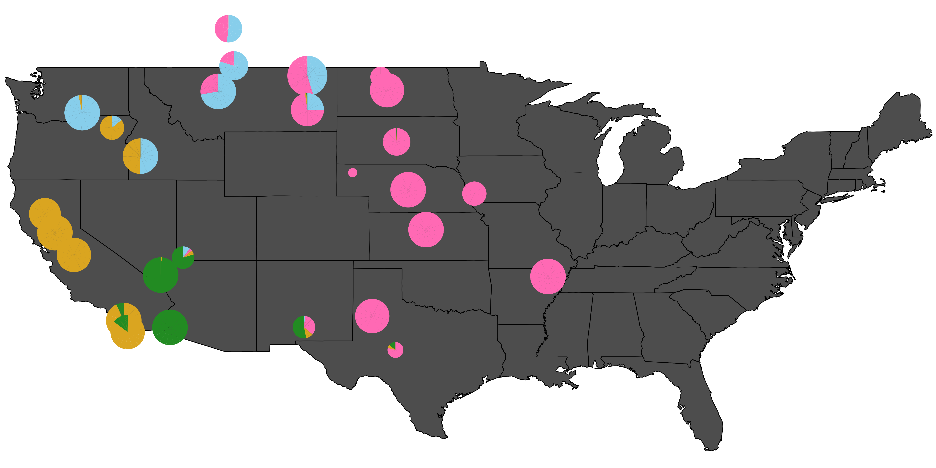
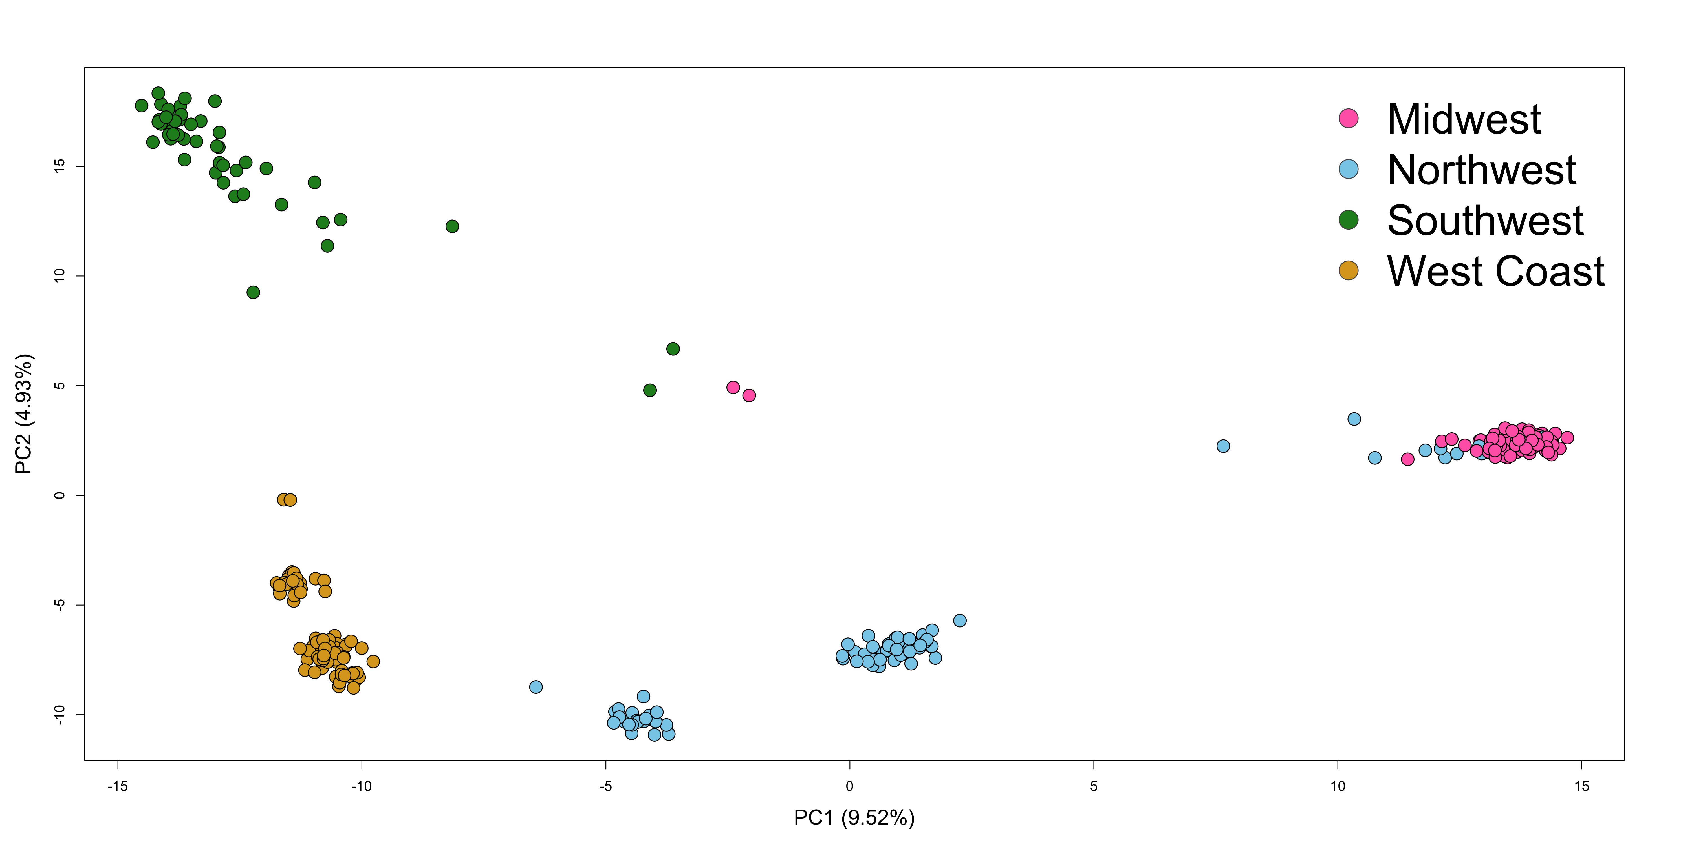
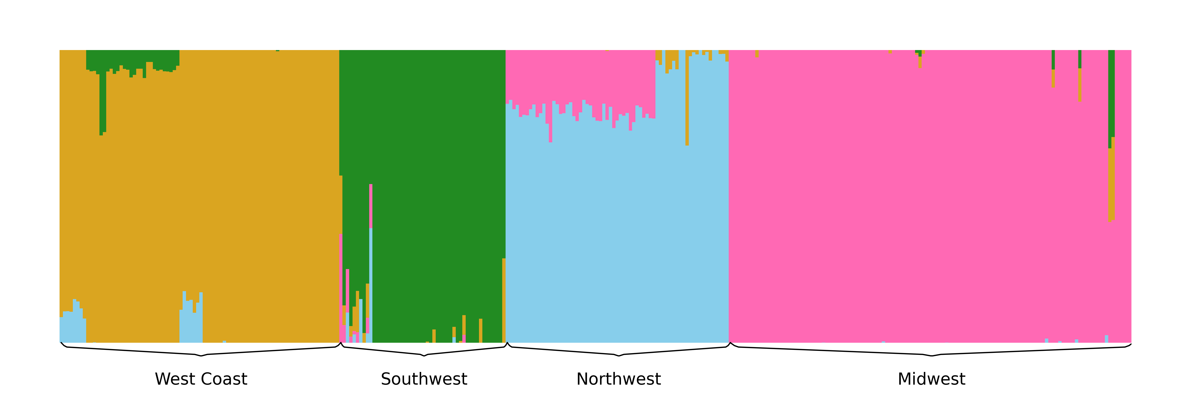
Pop. Structure - ADMIXTURE
Figure: Population Structure of Cx. tarsalis: (A) Floating pie charts of the admixture proportions in Cx. tarsalis populations sampled across the Western and Midwestern U.S and parts of Canada. Pie chart sizes are proportional to the sample size at each collection site. (B) ADMIXTURE results for K=4. Labels along the x-axis indicate sampling locations and colors correspond to the admixture proportion for each of the 4 clusters. (C) PCA results for the top 2 principal components, with points colored by the 4 geographic regions identified by ADMIXTURE.
(A)
(C)
(B)
Notes:
The admixture results shows us four major population clusters. I plot the result in both (A) and (B), In (B) we can see each sample with how much proportion of each cluster. From the PCA results, we can also notice this 4 distinct cluster. Addition, we can see in Southwest and Northwest region, it even has sub structures inside them.
sample bias about missing the sample locations in rocky mountain area
Need to mention about about the information of not include the samples from rocky mountains. And what we plan to do in the future to deal with this part.

Slide 26
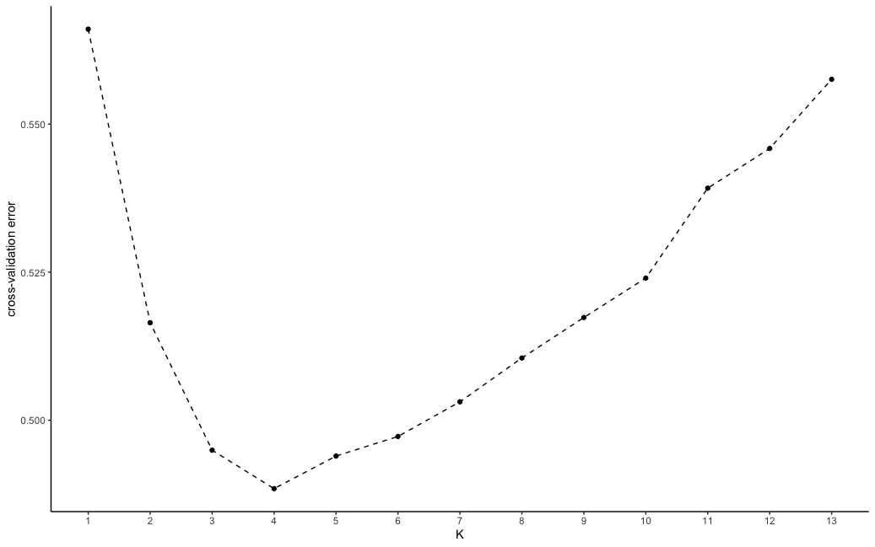
ADMIXTURE – Supplemental Data
Cross Validation Errors from K=1 to K=13

Slide 27
Pop. Structure – AMOVA
Table: Results of Analysis of Molecular Variance (AMOVA)
Source of Variation | Degree of Freedom (Df) | Sum of Squares | Mean Squares | % of Variation | Phi - statistics
Within populations | 286 | 399769.91 | 1397.80 | 77.27 | ɸ-populations-total = 0.2273
Between populations within regions | 32 | 53923.27 | 1685.10 | 1.85 | ɸ-populations-regions = 0.0234
Between regions | 3 | 93341.38 | 31113.79 | 20.88 | ɸ-regions-total = 0.2088
Total | 321 | 547034.55 | 1704.16 | 100.00
Notes:
AMOVA, or Analysis of Molecular Variance, is a statistical method used to analyze genetic variation within and between populations. AMOVA is like breaking down the genetic differences into portions to see where the differences are bigger — within groups or between them.
The AMOVA results shows that most of the genetic diversity, about 77%, occurs within individual populations. This means that there's a lot of variation among individuals in the same population. In contrast, only about 21% of the genetic diversity is due to differences between larger regions, indicating distinct genetic profiles on a regional basis. Interestingly, there's very little variation, just under 2%, between populations within the same region, suggesting that these populations are quite similar genetically.
This setup helps us understand not only how much genetic variation exists, but also how it's structured geographically among the populations we studied.
n
Here we specify the AMOVA hierarchy is region/population/samples
understand amova test compare to anova
to add the reference for the methods

Slide 28
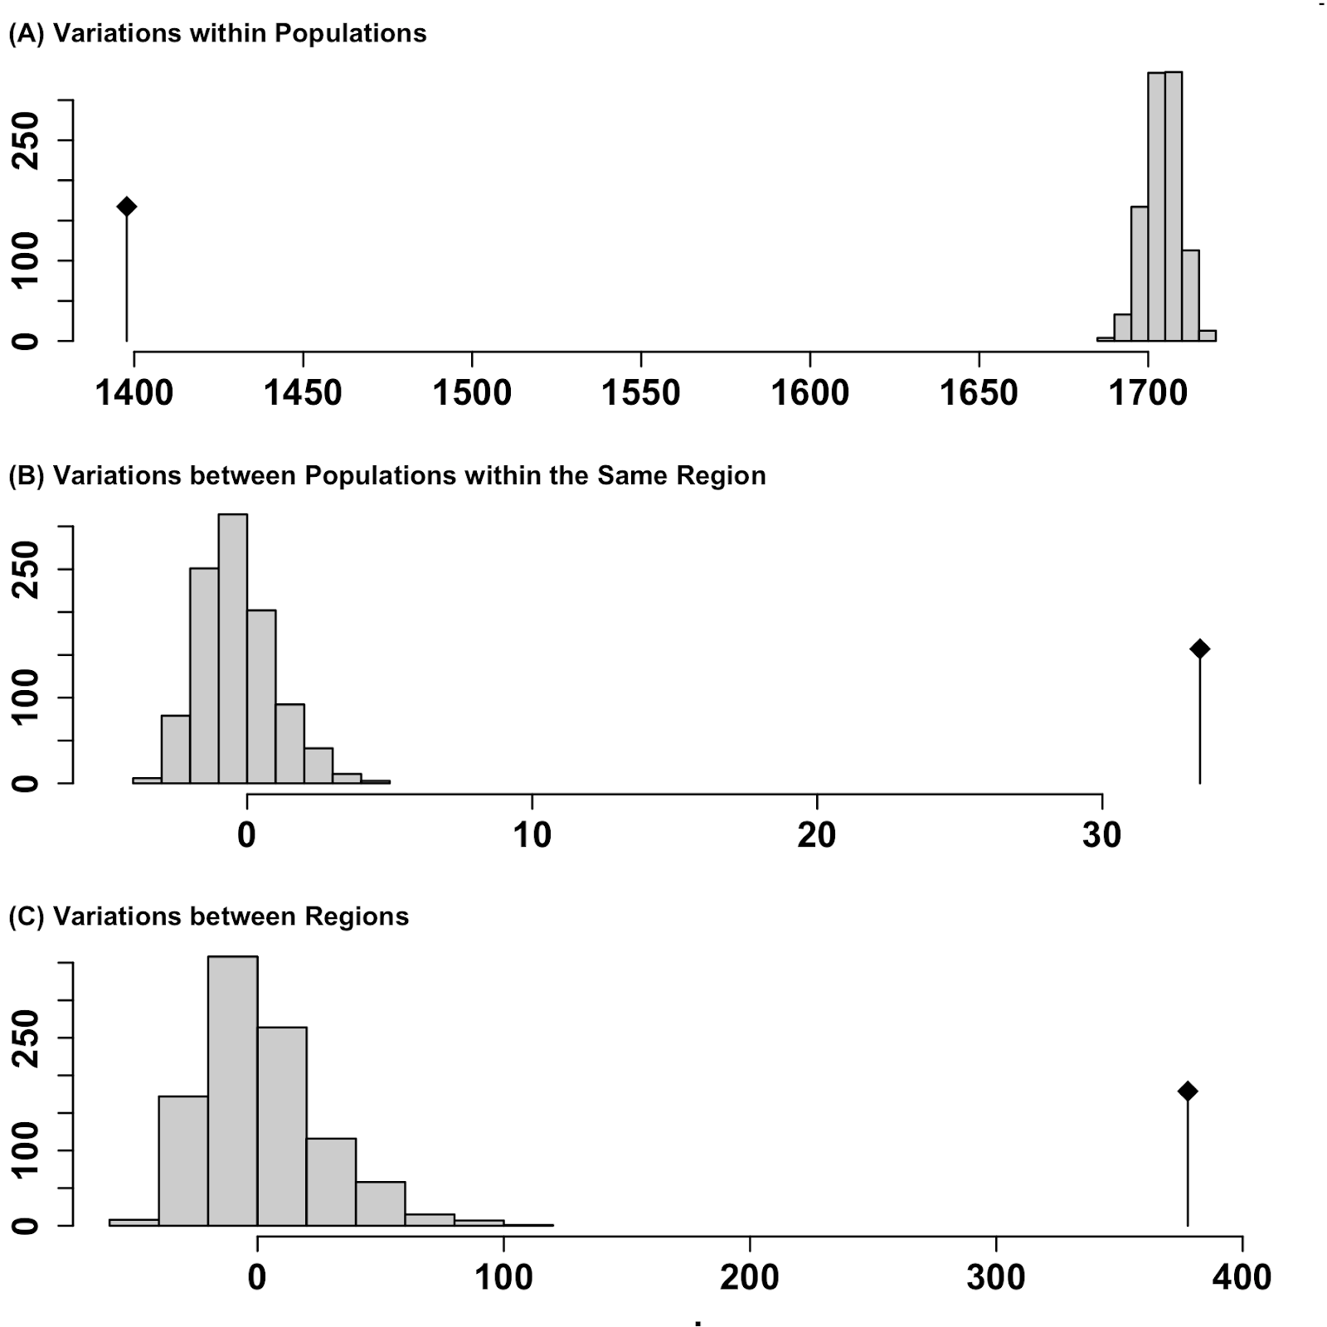
Pop. Structure – AMOVA Significance
Table: Randomization Test Results
Monte-Carlo tests - permutation number: 999
Test | Obs. | Std. Obs | Alter | Pvalue
Variations within populations | 1397.80 | -62.38 | less | 0.001
Variations between populations within regions | 33.42 | 26.25 | greater | 0.001
Variations between regions | 377.71 | 15.13 | greater | 0.001
Notes:
To test if populations are significantly different, we perform a randomization test using the function randtest() from the ade4 package. This will randomly permute the sample matrices. From this result, we can see three histograms representing the distribution of the randomized strata. The black line represents the observed data. The table of observed results in the output showing that there is significant population structure considering all levels of the population strata.
* the term “observation” refers to the amount of genetic variation measured by AMOVA test.
* a standardized observation (Std. Obs) value close to 0 often indicates that the observed data are not markedly different from what would be expected under the null hypothesis of no differentiation or effect.
Monte Carlo Test: Involves generating random samples from a known probability distribution to approximate the sampling distribution of a test statistic under the null hypothesis. This method relies on repeated random sampling to estimate probabilities.
Permutation Test: Involves shuffling or permuting the observed data to create a large number of possible rearrangements of the data. It then calculates the test statistic for each permutation to construct the empirical sampling distribution of the test statistic under the null hypothesis.
* Standardization: This process typically involves subtracting the mean and dividing by the standard deviation.

Slide 29
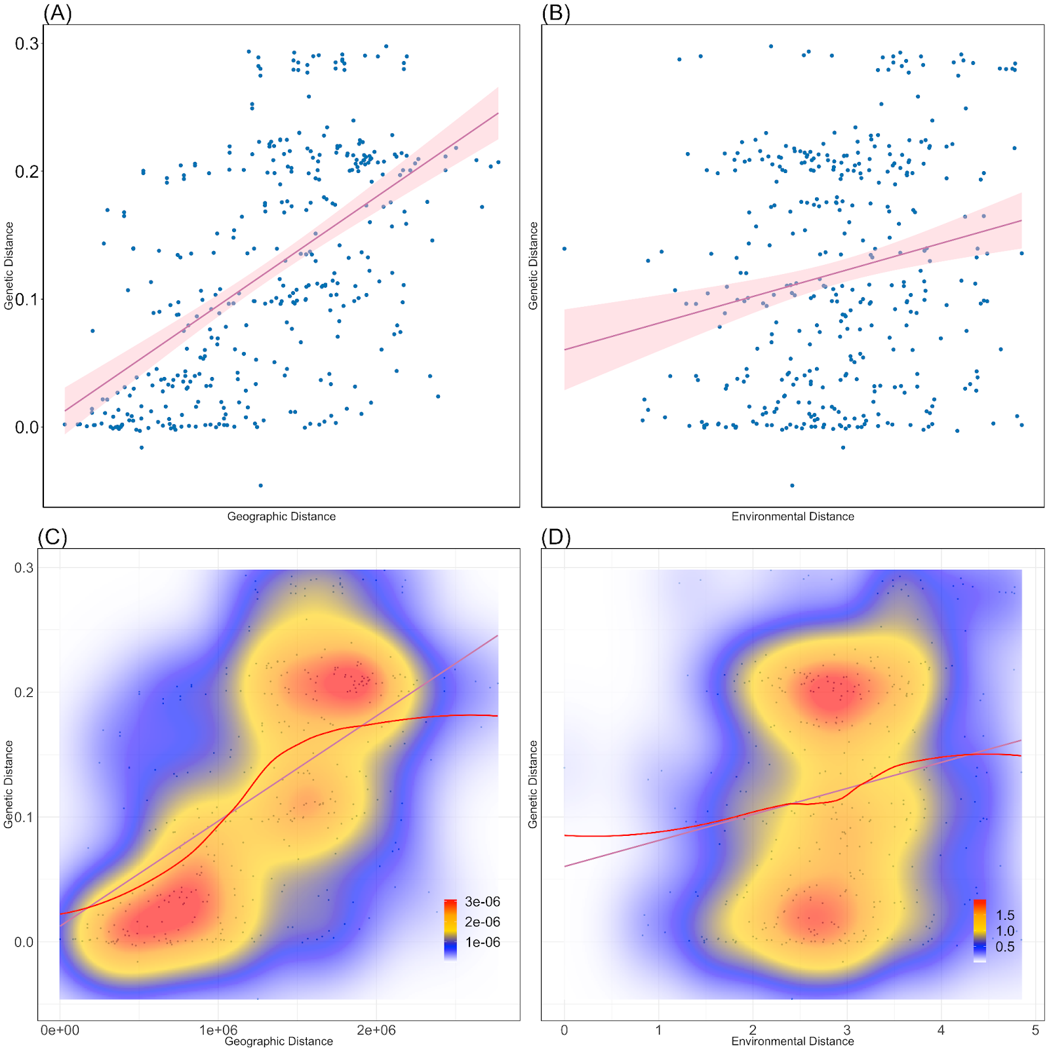
Pop. Structure – IBD & IBE Visualization
Figure: Isolation-by-Distance and Isolation-by-Environment. (A) Pairwise geographic distance versus genetic distance (F_{ST}) with best fit linear regression model (red line: y = 0.012+8.410-8x, R²=0.3). (B) Pairwise environmental distance versus genetic distance with best-fit linear regression mode (red line: y=0.06+0.021x, R²=0.04). (C)Kernel density plot with best fit spline for geographic distance versus genetic distance. Areas of high, intermediate, and low density are represented by red, yellow, and blue colors, respectively. (D) Kernel density plot with best-fit spline for environmental distance versus genetic distance.
Notes:
For IBD and IBE, firstly we construct three matrices represent Genetic distance matrix, environmental distance matrix and geographic distance matrix.
Firstly, I visually plot the Genetic distance matrix against Geographic distance and environmental distances. From the plot we can see geographic distance are more linear correlated to genetic distance than environmental distance, However , in plot (C), the red line, which is a smoothed local mean (LOESS smooth), indicates that the relationship is not linear.
Adding a test between geo distance and environmental distance.
practice the eye contacts
reduce the number

Slide 30
Pop. Structure – IBD & IBE Quantification
IBD Result
IBE Result
> IBD <- vegan::mantel(mat.gen,mat.geo, method="spearman", permutations=9999)
> IBD
Mantel statistic based on Spearman's rank correlation rho
Call:
vegan::mantel(xdis = mat.gen, ydis = mat.geo, method = "spearman", permutations = 9999)
Mantel statistic r: 0.5661
Significance: 1e-04
Upper quantiles of permutations (null model):
90% 95% 97.5% 99%
0.0792 0.1071 0.1332 0.1683
Permutation: free
Number of permutations: 9999
> IBE <- vegan::mantel(mat.gen,dist.env, method="spearman", permutations=9999)
> IBE
Mantel statistic based on Spearman's rank correlation rho
Call:
vegan::mantel(xdis = mat.gen, ydis = dist.env, method = "spearman", permutations = 9999)
Mantel statistic r: 0.1866
Significance: 0.011
Upper quantiles of permutations (null model):
90% 95% 97.5% 99%
0.0918 0.1260 0.1574 0.1919
Permutation: free
Number of permutations: 9999
Notes:
Then, in order to quantify the linear relationship between genetic, geographic and environmental distances, I perform a Mantel test based on Pearson's product-moment correlation.
IBD & IBE:
The Mantel statistic (r = 0.5661) indicates a positive correlation, with over half the possible maximum compared to IBE, which is r = 0.1866. This means that the population genetically farther apart are more linear correlated to geographic distance than environmental distance.
The Mantel test is a statistical method used to assess the correlation between two distance or similarity matrices.

Slide 31
IBD & IBE Supplementary Results
The Mantel tests (Sokal and Rohlf 1995; Wagner and Fortin 2015) first assessed the correlation between genetic and geographic distance matrices, examining isolation by distance (IBD). Subsequently, the tests evaluated the correlation between genetic and environmental distances while controlling for geographic distance, aiming to uncover isolation by environment (IBE). The significance of these relationships was determined using 9999 permutations. IBD and IBE were quantified by comparing the Mantel correlation coefficients between genetic, geographic, and environmental distances.
Table: Mantel Test Results
Mantel Test | Mantel statistic r | Significance
IBD | 0.5661 | 0.0001
IBE | 0.1866 | 0.0115
Notes:
* The Mantel test is a statistical method used to assess the correlation between two distance or similarity matrices. It is commonly employed in fields such as ecology, genetics, anthropology, and geography, where researchers are interested in understanding relationships between entities, such as species or populations, across different spatial or temporal scales.
* Permutation Procedure: The test involves randomly permuting the rows and columns of one of the matrices while keeping the other matrix fixed. This random shuffling preserves the structure of one matrix while disrupting any potential relationship with the other matrix.
RESULTS:
In the Mantel test results for Isolation by Distance (IBD) and Isolation by Environment (IBE), a clear distinction is observed in the correlation strengths and their significance. The IBD test shows a Mantel statistic of 0.5661, indicating a moderate to strong positive correlation between genetic distance and geographic distance. This is significantly supported by a very low p-value of 0.0001, suggesting a robust influence of geographic distance on genetic variation.

Slide 32
IBD & IBE Supplementary Results
To ascertain if environmental factors influence genetic differences alongside geographic distance, a mixed model was utilized to analyze the relationships between genetic distance, geographic distance, and environmental distance. Concurrently, to address potential collinearity issues, Variance Inflation Factor (VIF) assessments (Wikipedia contributors 2023; O’brien 2007) were conducted.
Table: VIF results
Table: Mixed Model Results (Generalized Least Squares model)
Variables | VIF
genetic distance | 1.537177
geographic distance | 1.476724
Environmental distance | 1.070282
Models | AIC | BIC | k | AICc | AICcmin | BICew
Full | 689.701 | 709.375 | 5 | 689.862 | 0.959 | 0.771
Distance | 696.061 | 711.801 | 4 | 696.169 | 0.041 | 0.229
Environment | 1001.974 | 1017.713 | 4 | 1002.081 | 0.000 | 0.000
Notes:
RESULTS:
1 VIF: The low VIF results for the three distance matrices—genetic distance, geographic distance, and environmental distance—indicate low multicollinearity (de Jongh et al. 2015). This suggests that each distance matrix can be reliably included in the mixed model to investigate their relationships, as they contribute independently without significant collinear influence.
2. Mixed model: The mixed model results, showcasing the lowest AIC and BIC values for the Full model that includes both geographic and environmental distances, affirm the findings from the IBD and IBE analyses. This suggests that considering both geographic and environmental factors simultaneously provides a more comprehensive explanation of genetic distance variations than either factor alone. The moderate to strong correlation observed in IBD and the weaker correlation in IBE are echoed in the mixed model, where the combined effect of both distances is most significant in explaining genetic differences.

Slide 33
Workflow
ADMIXTURE
Population Structure Analysis
AMOVA
IBD & IBE
SIFT
Genotype-Environment Association
LFMM
RDA
Mapping and Annotating Candidate SNPs to Functional Gene
Common Genes
SNPs under Selection
PCAdapt
Bayescan

Slide 34
GEA - LFMM
LFMM – Latent Variable Mixed Model (“lfmm” R package)
Univariate statistics
We chose PC1 from PCA analysis of environmental dataset as the representation
Table: Results of PCA Analysis on Environmental Variables
 | PC1 | PC2 | PC3 | PC4 | PC5 | PC6 | PC7
Eigenvalue | 2.4326 | 1.4994 | 1.1709 | 0.69002 | 0.57216 | 0.45700 | 0.17785
Proportion Explained | 0.3475 | 0.2142 | 0.1673 | 0.09857 | 0.08174 | 0.06529 | 0.02541
Cumulative Proportion | 0.3475 | 0.5617 | 0.7290 | 0.82757 | 0.90931 | 0.97459 | 1.00000
Notes:
The Latent Factor Mixed Model (LFMM) is a statistical method primarily used in genetics to correct for confounding factors while identifying associations between genetic variations and traits of interest. This model is particularly useful in the study of complex traits where many factors might influence the genetic architecture.
For the univariate LFMM test, I could run a separate set of tests for each environmental variable; this would be a test for each of the 11,101,916 SNPs with each predictor which will be a total number of couple million tests. Instead, for LFMM, I performed a PCA on the environmental dataset and use the first principal component (PC) as a synthetic predictor.
Since the Principal Component predictor will be a linear combination of the original all environmental variables, this will reduce our ability to interpret the output, but it will reduce the number of corrections needed for multiple tests.

Slide 35
GEA - LFMM
Run PCA on environmental data
Use PC1 represent environmental variables
LFMM model
Under 10% FDR control
Total 91 candidate SNPs
SNPs data,
K=4
Lfmm_ridge(),
lfmm_test(),
GIF = 1.2
Notes:
Fit an LFMM with K latent variable = 4 factors
Lfmm_ridge() function computes regularized least squares estimates for latent factor mixed models using a ridge penalty.
Perform association testing using the fitted model:
Lfmm_test() returns p values are calibrated by using GIF, an estimate of the variance of z-scores.
A value of GIF close to 1 suggests that there is little to no inflation of test statistics due to population stratification or other confounders. A value significantly greater than 1 indicates potential inflation, suggesting that the results may be biased due to unaccounted factors such as population structure. This may lead to false positives, where non-associated genetic variants appear to be associated with the trait.
False Discovery Rate (FDR): The FDR is the expected proportion of false discoveries (false positives) among all discoveries (tests declared significant). Controlling the FDR means that, on average, a certain proportion of rejected null hypotheses (significant results) will be false discoveries.

Slide 36
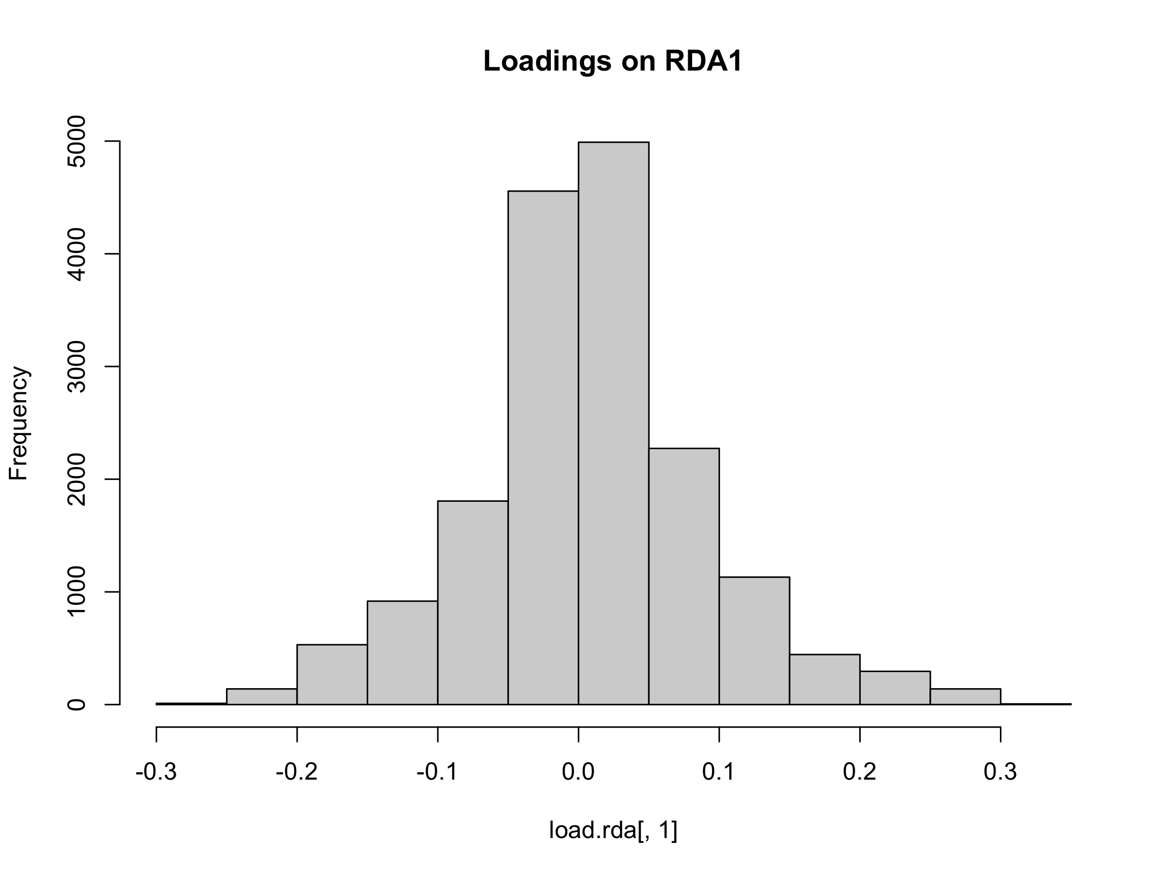
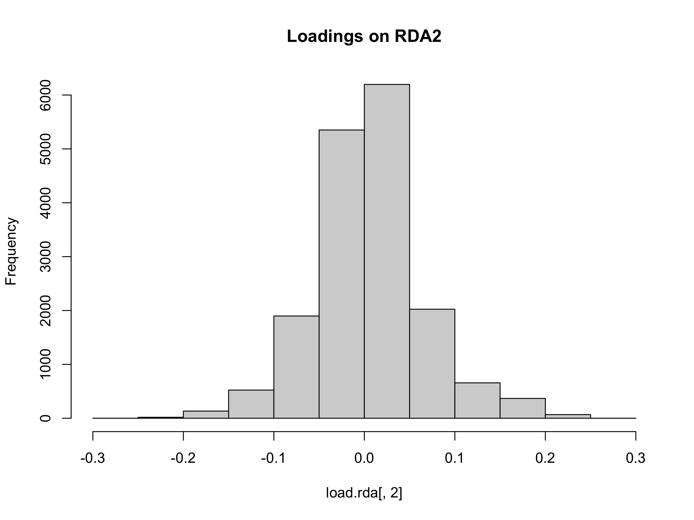
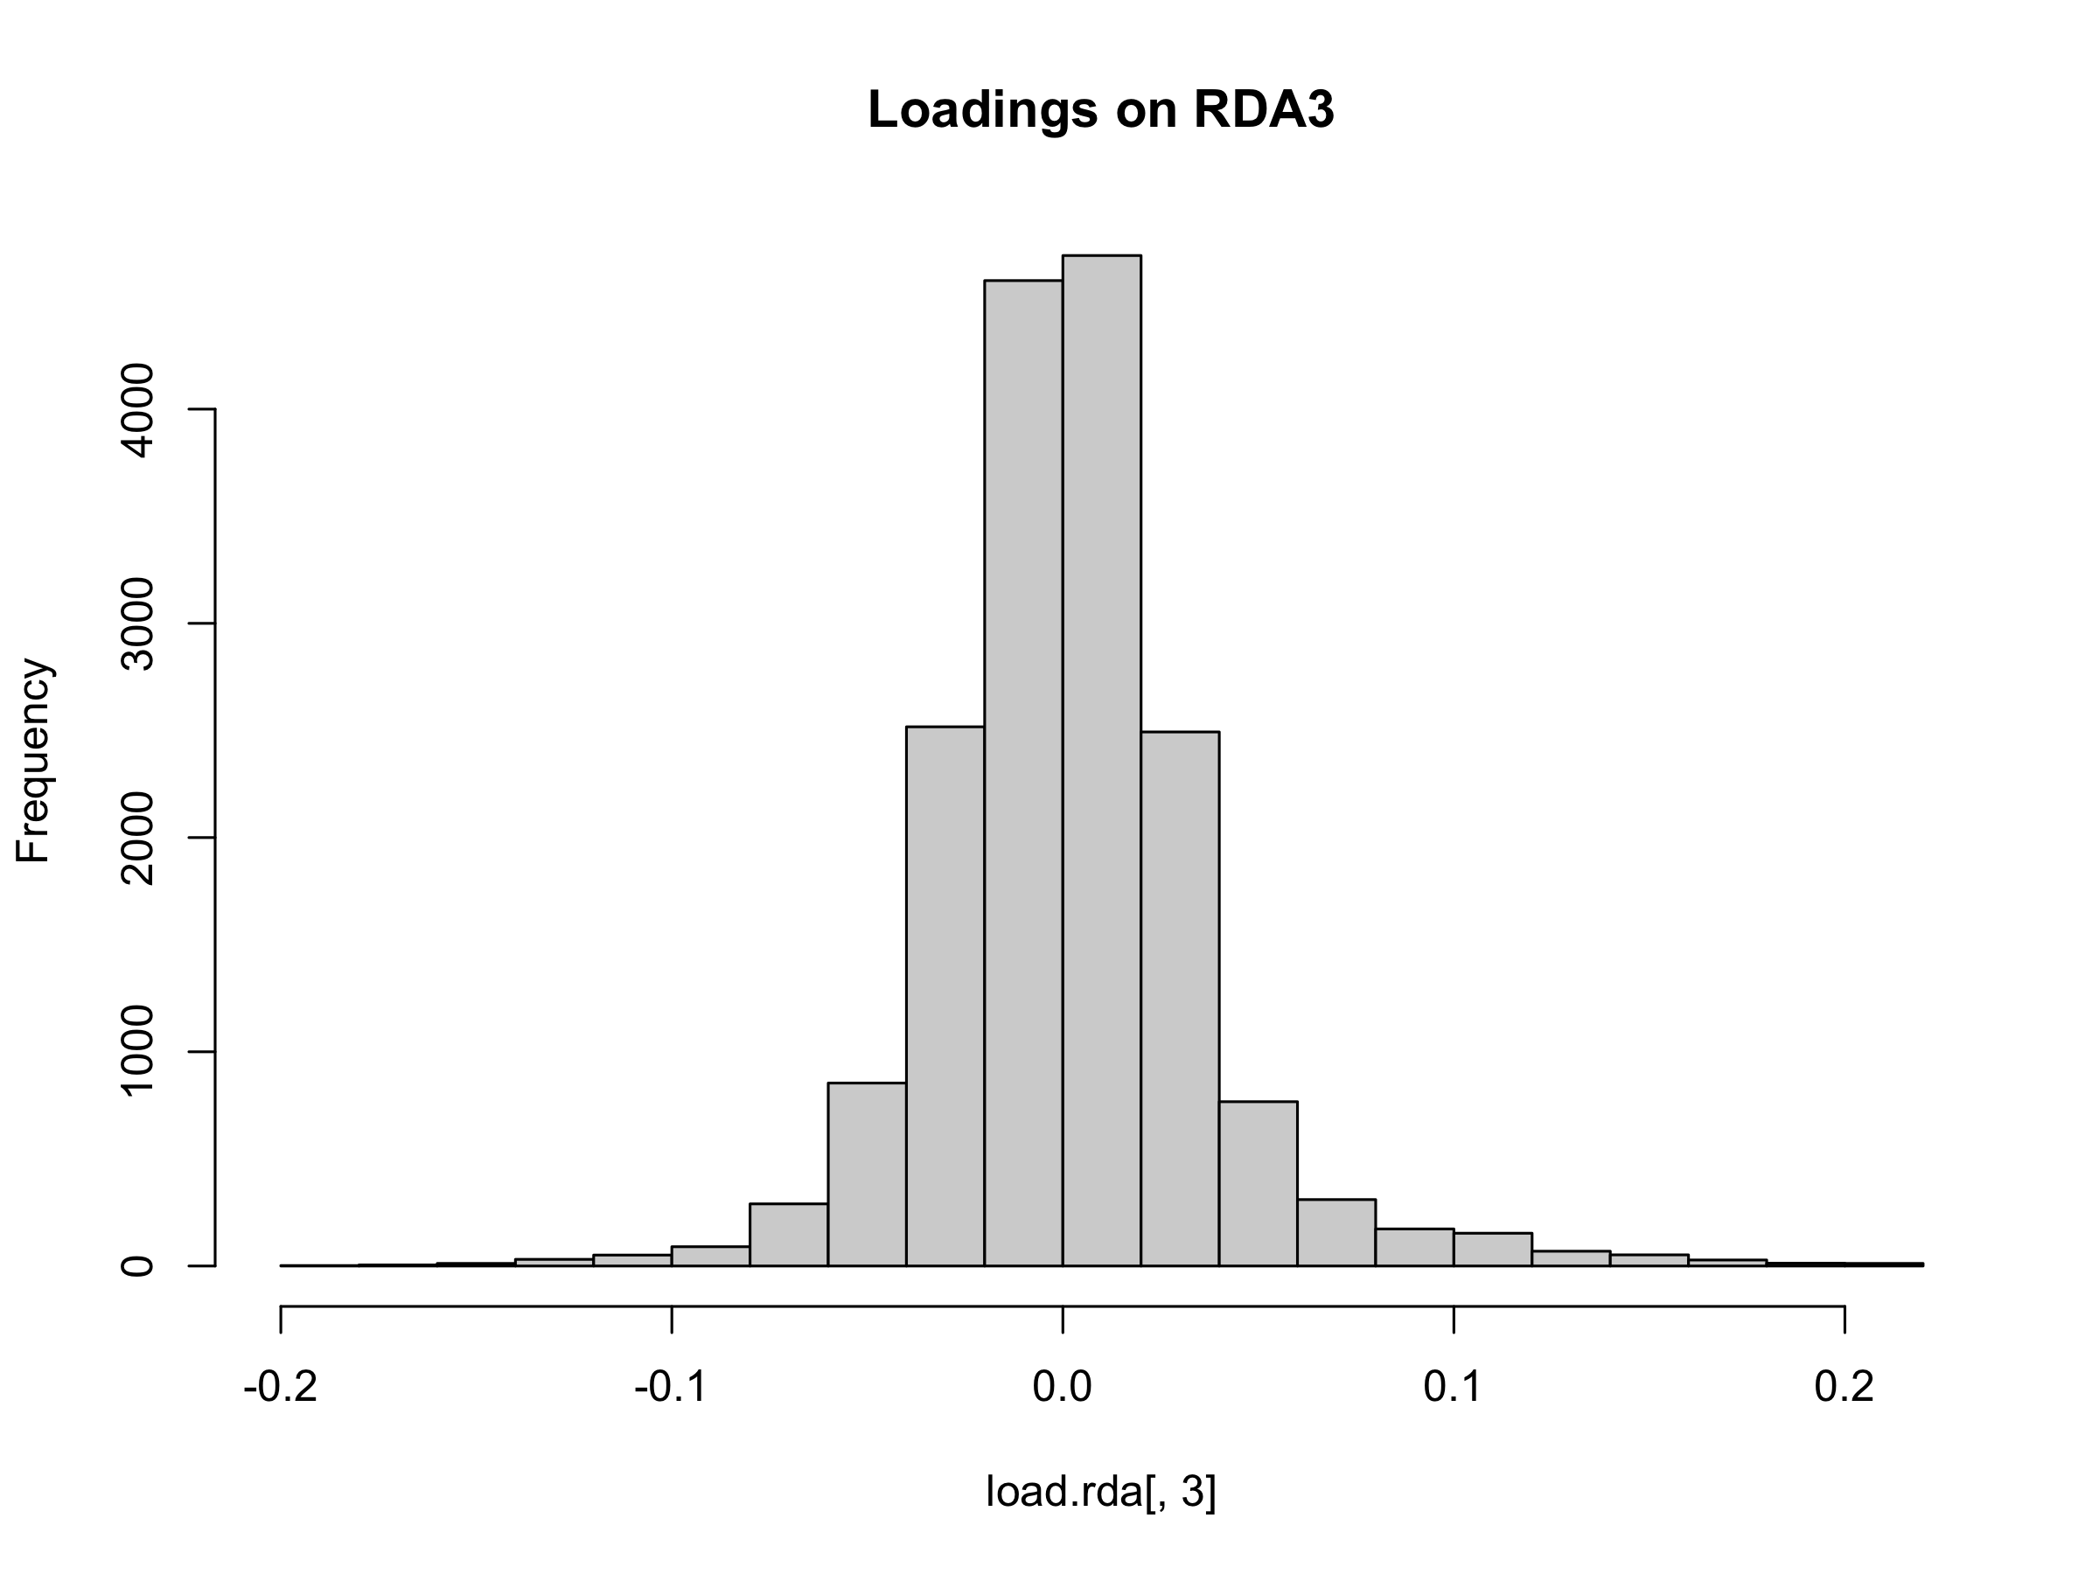
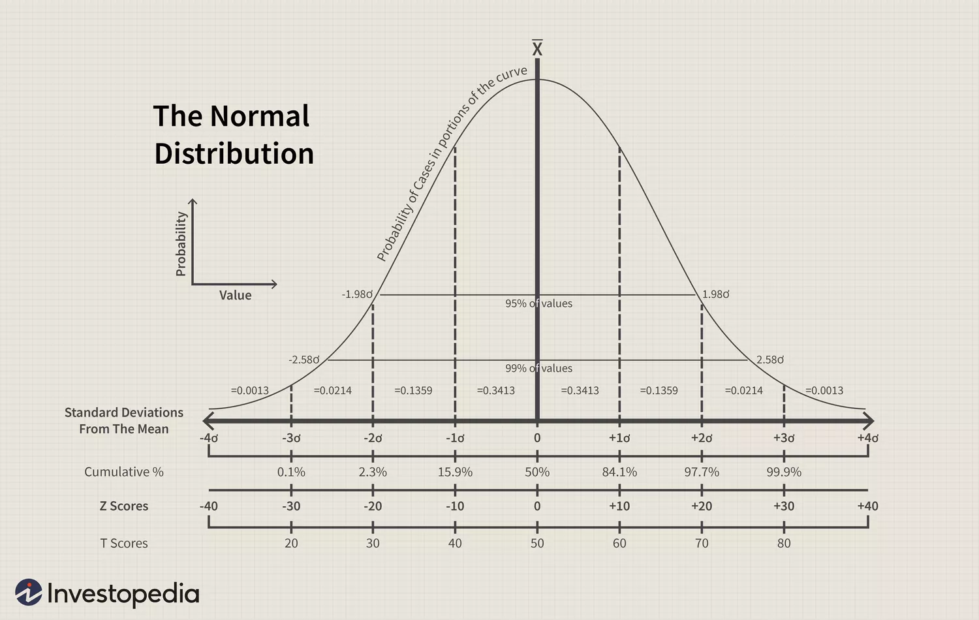
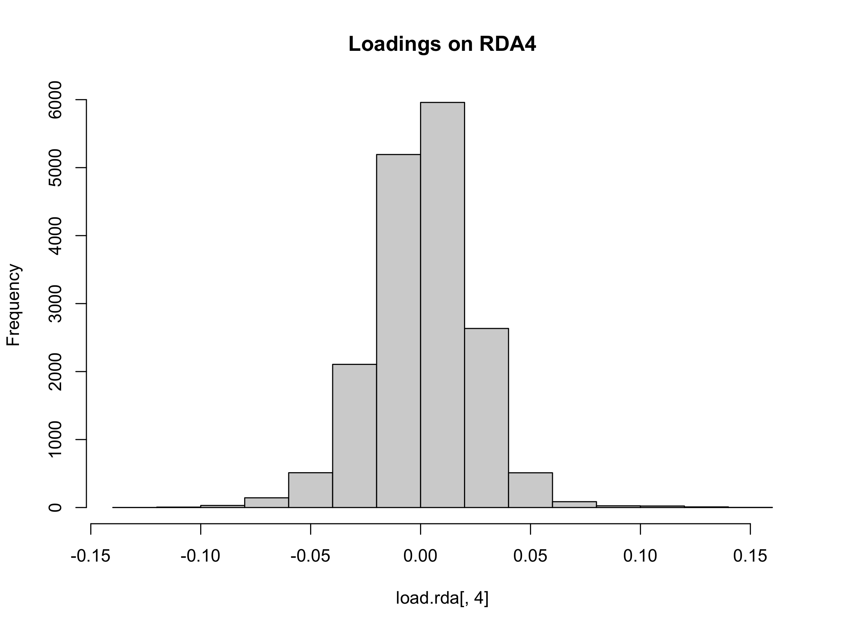
GEA - RDA
Table: RDA Significant Test (anova.cca(mos.rda, by="axis"))
RDA – Redundancy Analysis
Multivariate statistics
 | Df | Variance | F | Pr(>F) | Significance
Full Model | 8 | 1796.3 | 4.5511 | 0.001 | ***
RDA1 | 1 | 894.1 | 18.1217 | 0.001 | ***
RDA2 | 1 | 469.8 | 9.5231 | 0.001 | ***
RDA3 | 1 | 158.7 | 3.2158 | 0.001 | ***
RDA4 | 1 | 69.8 | 1.4154 | 0.001 | ***
RDA5 | 1 | 56.8 | 1.1517 | 0.094 | .
RDA6 | 1 | 51.1 | 1.0361 | 0.591
RDA7 | 1 | 48.6 | 0.9855 | 0.901
RDA8 | 1 | 47.3 | 0.9592 | 0.901
Constrained axis Residual | 313 | 15442.7
Run Permutation Test on RDA Axes
anova.cca()
First 4 RDA Cons. Axes Significant
Identify RDA candidates on each axis that significantly deviated (3 sd) from the mean loadings
Choose SNP loadings on the first 4 axes
Total 822 Candidate SNPs
Table: Summarize of RDA table
 | Inertia | Proportion
Total | 17239 | 1.0000
Constrained | 1796 | 0.1042
Unconstrained | 15443 | 0.8958
Run RDA model
Significant Code: 0 ‘***’ 0.001 ‘**’ 0.01: ‘*’ 0.05 “.” 0.1 ‘ ‘ 1
Notes:
RDA is a multivariate technique that can analyze many loci and environmental predictors simultaneously. For this case, we don’t need to reduce the dimensions use PCA
In order to choose which RDA constrained axes will be considered to be included when we search for candidate SNP later, I started by investigating RDA axes that explain the most variance.
Here I performed ANOVA like Permutation test (anova.cca() function in R) on the RDA object axes to see which constrained axes are statistically significant.
Within 3 standard deviations (z = 3): Approximately 99.7% of the data falls within this range. So we consider the rest of the 0.3% as our environmental adapted candidate SNPs.
When you call anova.cca with the argument by="axis", you're asking for the function to test the significance of each RDA axis individually.
write down

Slide 37
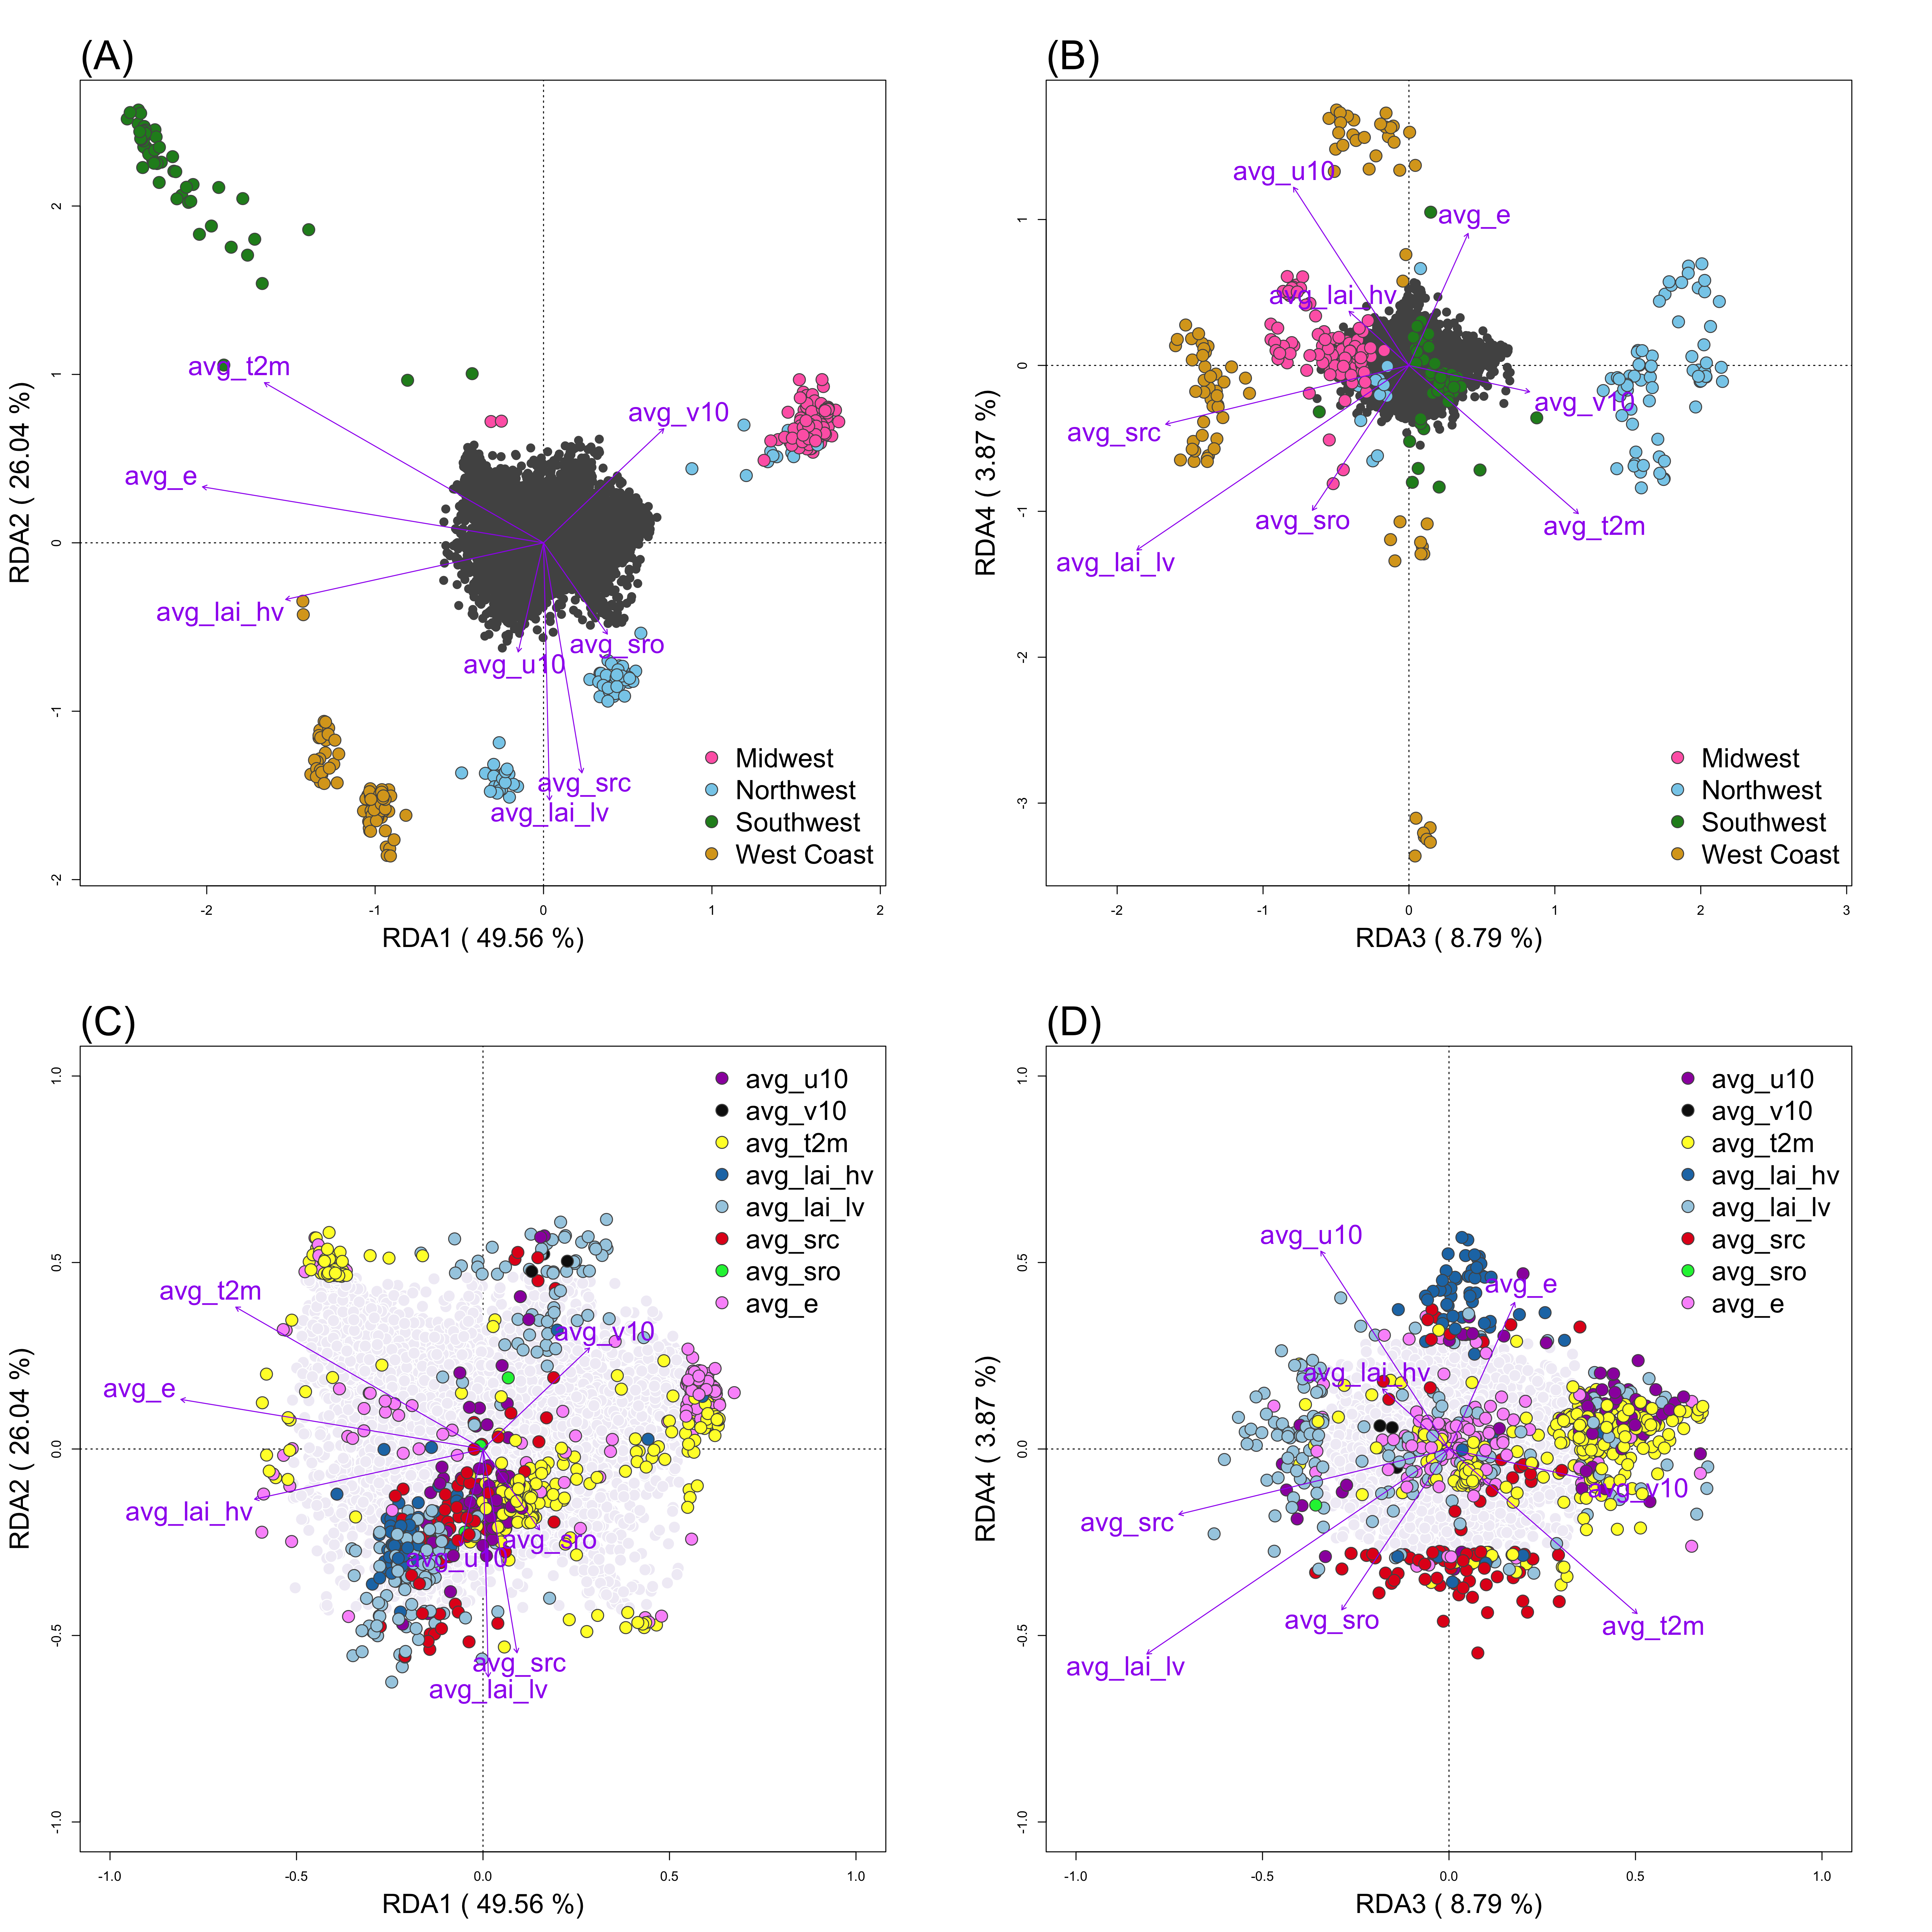
GEA - RDA Results
Figure: Environmental Correlates of Genetic Variation in Cx. tarsalis Across Diverse North American Regions. Panels A and B display the relationship between environmental factors and the distribution of Cx. tarsalis, using RDA to illustrate how regional differences affect genetic variation. In these panels, the position of each circle (representing an individual mosquito) and color (indicating regional groupings from ADMIXTURE results) reflects their association with environmental variables, shown as purple vectors. The first plot (A) focuses on RDA1 and RDA2, the primary axes explaining the most variance, while the second (B) explores more subtle influences in RDA3 and RDA4. Panels C and D shift focus to SNPs within the genetic data, colored to signify their strongest environmental association. These latter plots further detail the genetic-environment relationship, with the SNPs' distribution providing insight into the adaptive landscape of these populations.
Notes:
RDA plot（A) and (B), Focus on the sample locations against the environmental vectors. The angle between the sample and environmental vector can tells us the relationship. The smaller the angle is, the stronger the correlation is between the environmental vector and samples. The longer the vector is, the stronger effect the vector will be.
Plot (C) and (D) move the focus to the candidates SNPs and environmental variables. We can see a mixture of different environmental focus towards different SNPs.

Slide 38
Workflow
ADMIXTURE
Population Structure Analysis
AMOVA
IBD & IBE
SIFT
Genotype-Environment Association
LFMM
RDA
Mapping and Annotating Candidate SNPs to Functional Gene
Common Genes
SNPs under Selection
PCAdapt
Bayescan

Slide 39
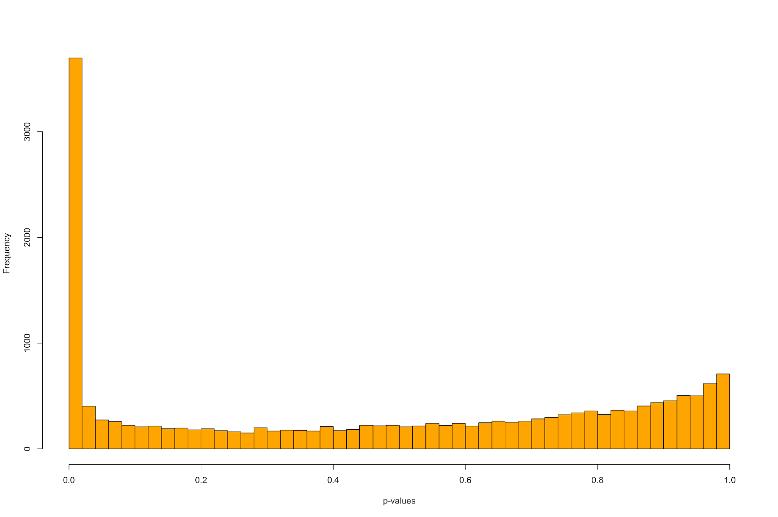
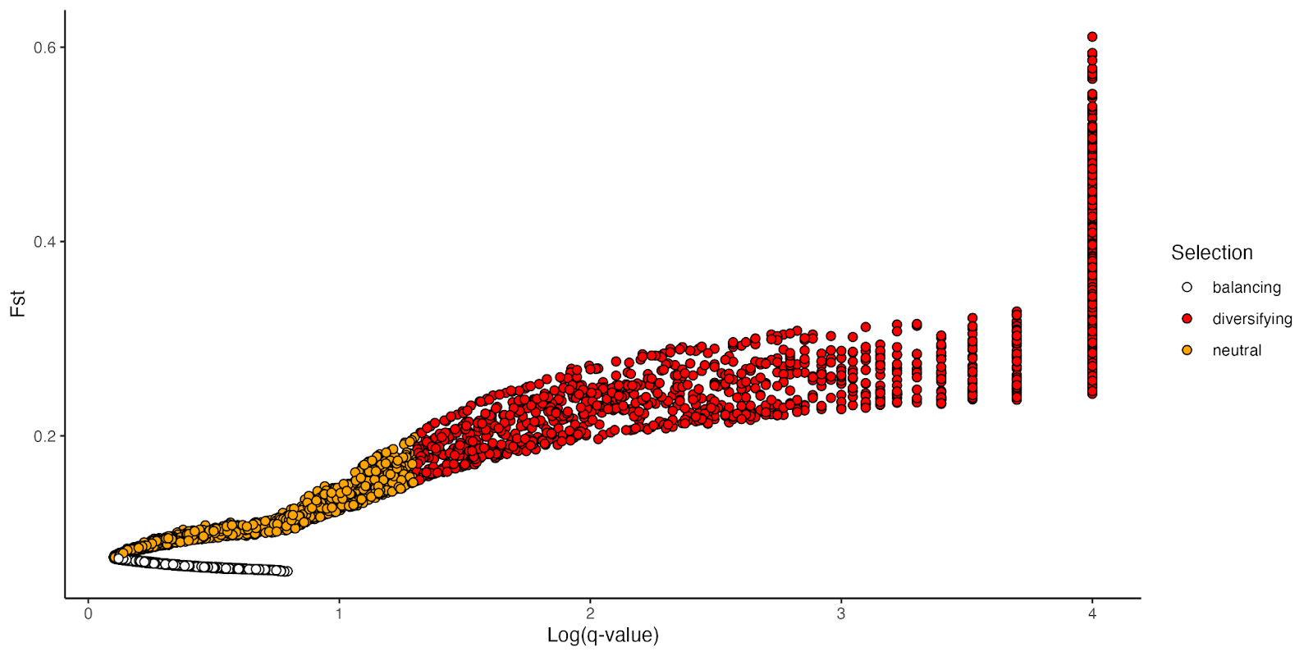
SNPs under Selection
PCAadpt
Choose the top 1% of extreme p-values
Total 173 Candidate SNPs
Bayescan
Total 1836 Candidate / diversifying SNPs

Slide 40
Workflow
ADMIXTURE
Population Structure Analysis
AMOVA
IBD & IBE
SIFT
Genotype-Environment Association
LFMM
RDA
Mapping and Annotating Candidate SNPs to Functional Gene
Common Genes
SNPs under Selection
PCAdapt
Bayescan

Slide 41
Functional Gene Annotation
Gene annotation was completed by MAKER using EST and protein data from the Culex quinquefasciatus and Aedes aegypti mosquitoes.
Employed Trinotate and InterProScan for functional annotation of predicted genes, leveraging EST and protein data from Culex quinquefasciatus and Aedes aegypti.

Slide 42
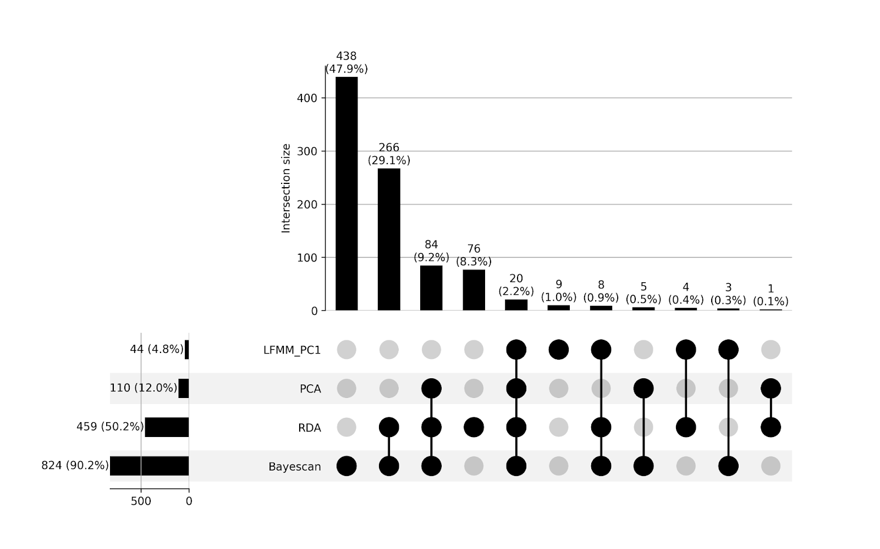
GEA and Selection Overlapping
After mapping and annotating the candidate SNPs, we found 20 overlapping genes between 4 methods.
Figure: Upset Plot of within Genes Annotated from Candidate SNPs Identified for Local Adaptation and Environmental Association Across LFMM, RDA, Pcadapt, and BayeScan Analysis in Cx. tarsalis

Slide 43
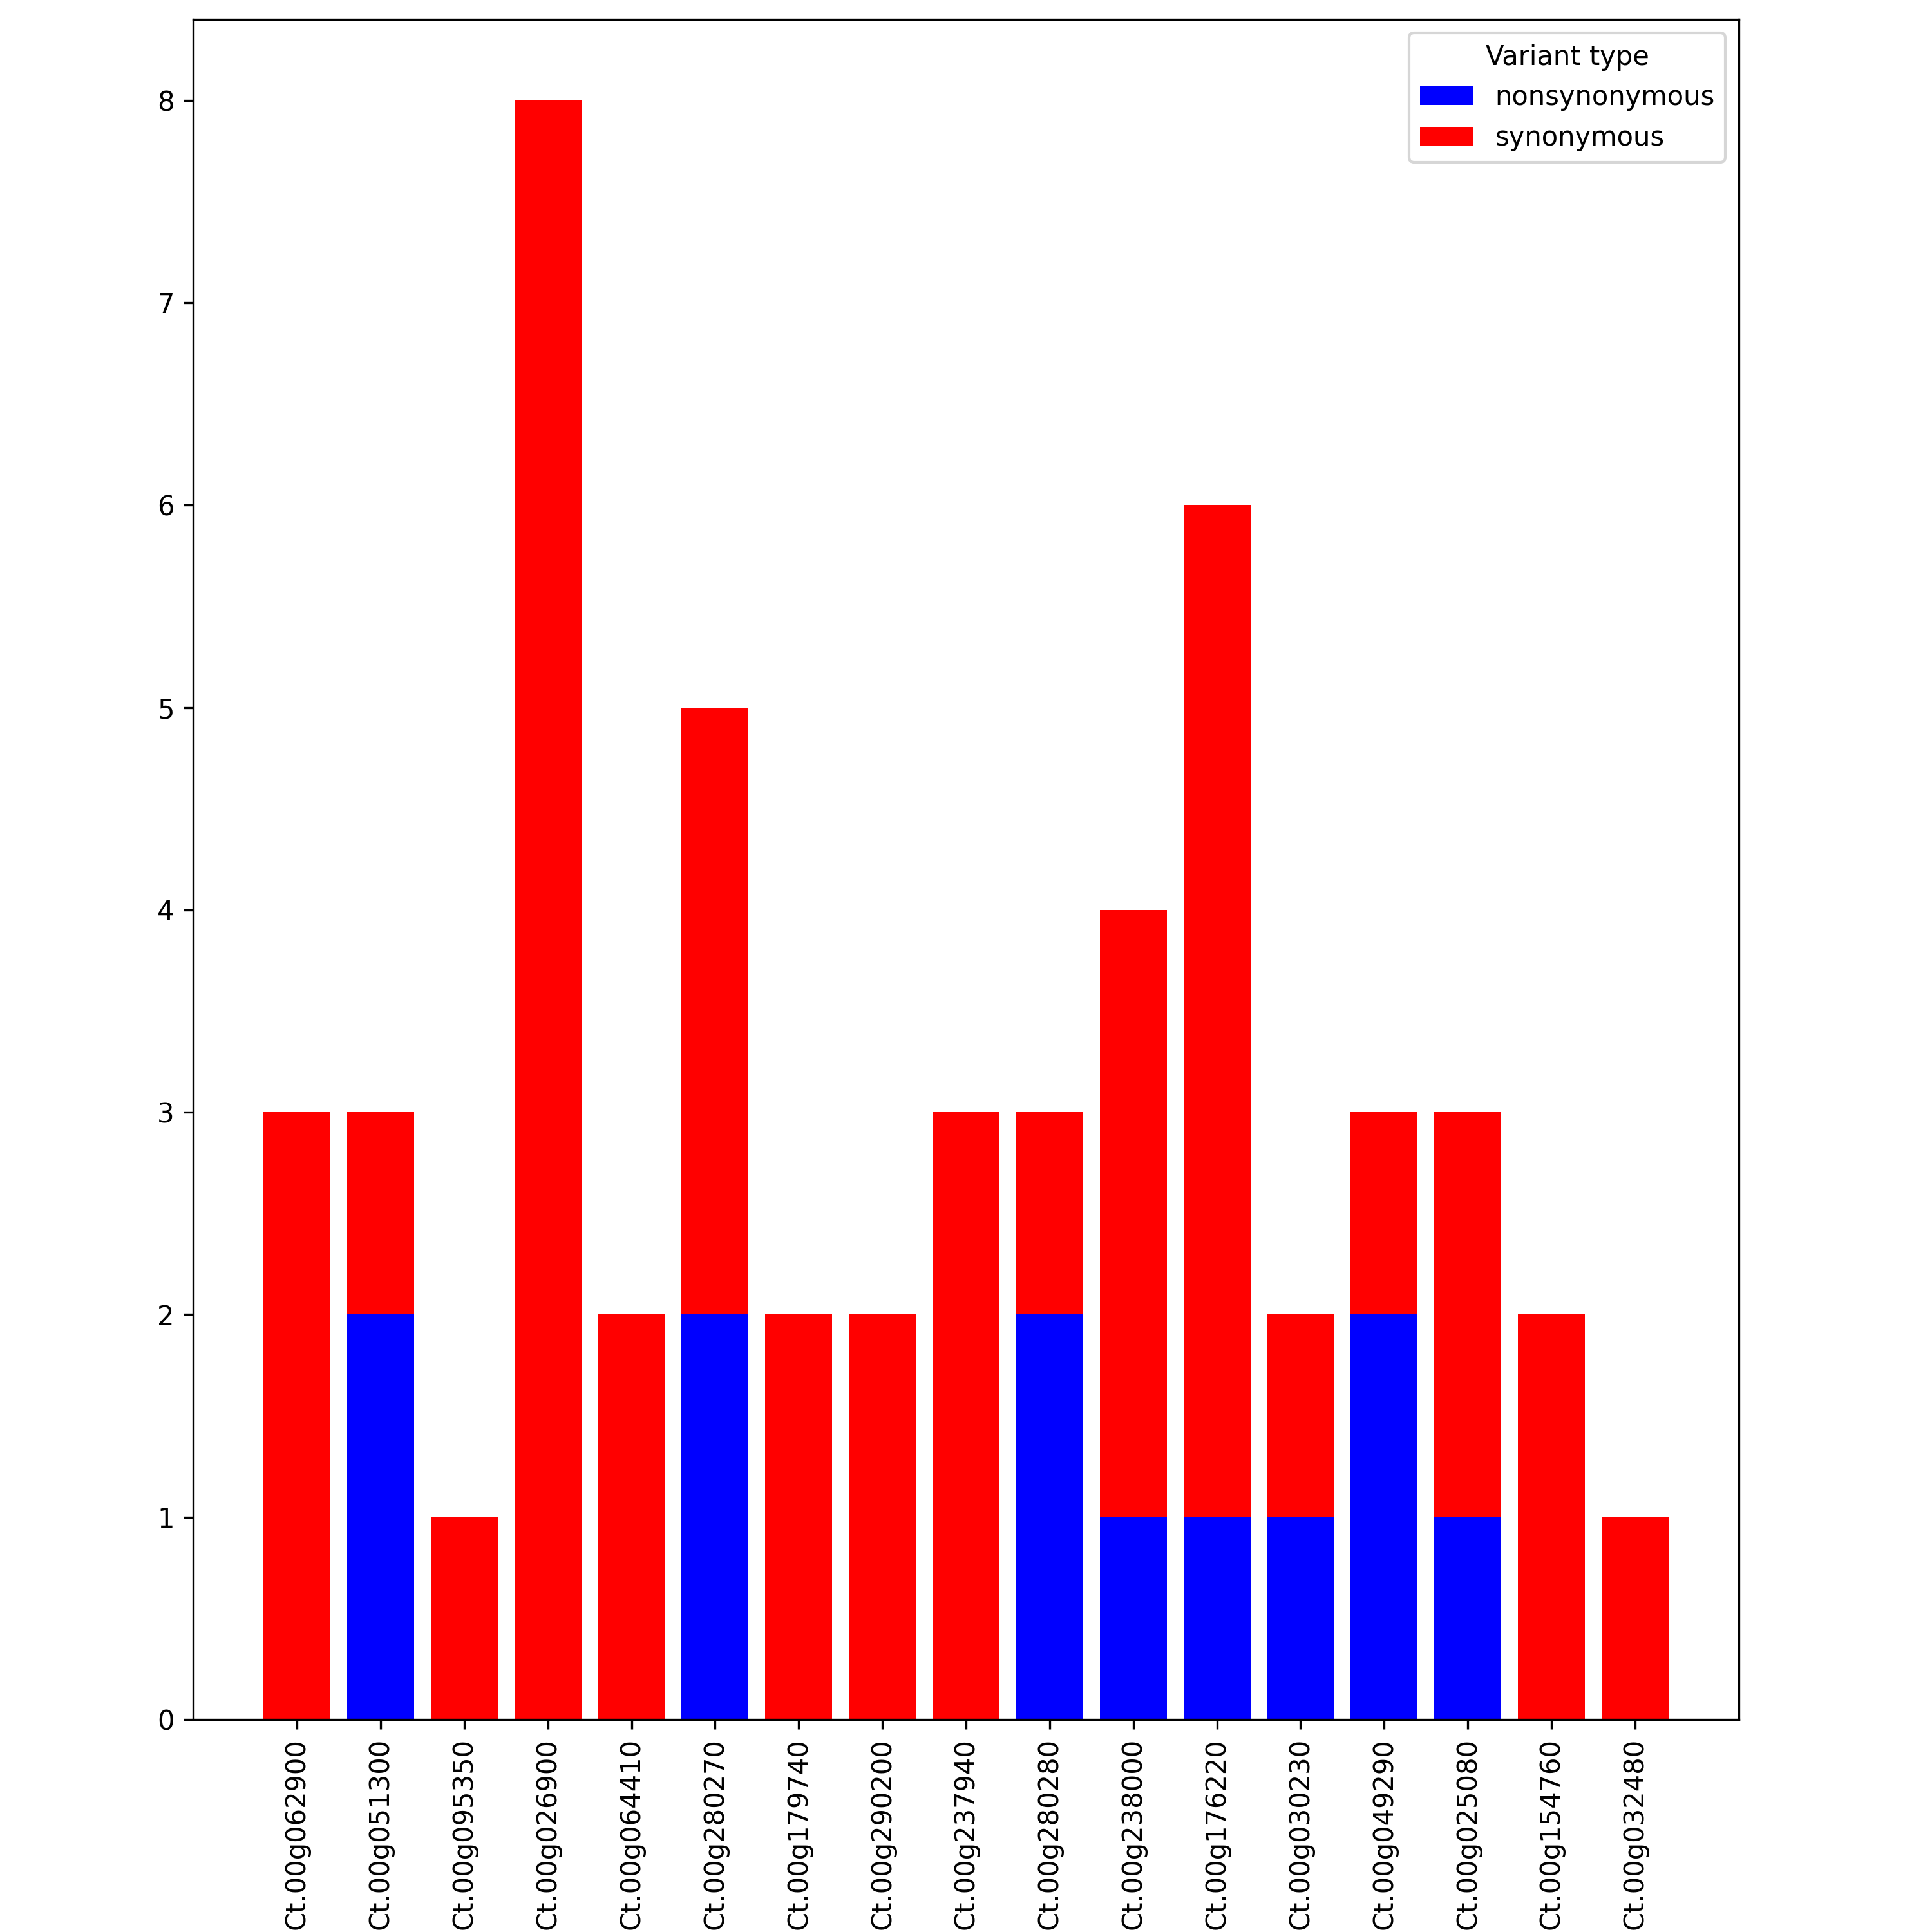
SIFT
The SIFT4G predictions determined that 17 of the 20 overlapping candidate genes located within the coding region, and 8 of these genes contained nonsynonymous mutations within our dataset.
Figure: Comparative Bar Chart of Synonymous and Nonsynonymous SNPs Across 17 genes
Notes:
SIFT is a computational tool utilized to discern the potential impact of non-synonymous SNPs (single nucleotide polymorphisms) on the function of proteins.

Slide 44
SIFT
Table: SIFT4G results for candidate SNPs within Genes
Gene_ID | total_SNPs | nonsynonymous |  |  | synonymous
 |  | total | tolerated | deleterious | total | tolerated | deleterious
Ct.00g025080 | 3 | 1 | 1 | 0 | 2 | 2 | 0
Ct.00g026900 | 8 | 0 | 0 | 0 | 8 | 8 | 0
Ct.00g030230 | 2 | 1 | 1 | 0 | 1 | 1 | 0
Ct.00g032480 | 1 | 0 | 0 | 0 | 1 | 1 | 0
Ct.00g049290 | 3 | 2 | 1 | 1 | 1 | 1 | 0
Ct.00g051300 | 3 | 2 | 2 | 0 | 1 | 1 | 0
Ct.00g062900 | 3 | 0 | 0 | 0 | 3 | 3 | 0
Ct.00g064410 | 2 | 0 | 0 | 0 | 2 | 2 | 0
Ct.00g095350 | 1 | 0 | 0 | 0 | 1 | 1 | 0
Ct.00g154760 | 2 | 0 | 0 | 0 | 2 | 2 | 0
Ct.00g176220 | 6 | 1 | 1 | 0 | 5 | 5 | 0
Ct.00g179740 | 2 | 0 | 0 | 0 | 2 | 2 | 0
Ct.00g237940 | 3 | 0 | 0 | 0 | 3 | 3 | 0
Ct.00g238000 | 4 | 1 | 0 | 1 | 3 | 3 | 0
Ct.00g280270 | 5 | 2 | 2 | 0 | 3 | 3 | 0
Ct.00g280280 | 3 | 2 | 2 | 0 | 1 | 1 | 0
Ct.00g290200 | 2 | 0 | 0 | 0 | 2 | 2 | 0
Seminal Plasma Protein (reproductive success)
Period Circadian Protein (circadian rhythms and diapause adaptation)
Defective Proboscis Extension Response DPR-related (feeding habit)
Carnitine O-acyltransferase (fat metabolism and adaptation)
Notes:
SIFT is a computational tool utilized to discern the potential impact of non-synonymous SNPs (single nucleotide polymorphisms) on the function of proteins.
From all the 17 genes’ functional annotation results, we found crucial biological functions such as circadian rhythms, reproductive success, feeding habits and fat metabolism, these four are directly have affect on help culex tarsalis to adapt the local environments. This information lay the groundwork for a detailed exploration of the genetic mechanisms driving adaptation in diverse environmental conditions. This might also help us to understand how Culex Tarsalis expanded from west coast towards east across rocky mountains.

Slide 45

Can Env. Alone Predict WNV?
Notes:
Since the Culex Tarsalis is one of the major WNV vectors, and environmental factors will affect their adaptation. Based on these, can we predict WNV with environments alone?

Slide 46
4. WNV Prediction

Slide 47
Data Source -- Disease Data
Clinical Disease Surveillance data
 | Frequency | Granularity | Period
CDC Human^{[1]} | Yearly | County Level | 1999 - 2023
CDC non-Human^{[2]} | Weekly | County Level | 2003 - 2021
California Human^{[3]} | Weekly | County Level | 2004, 2005, 2006, 2010, 2011 and 2012
[1] Specify the number of cases detected in WNND, WNF and Blood donation separately.
[2] Non-human includes birds, Mosquitoes and horses.
[3] The dataset includes human, bird, mosquitoes and sentinel chicken.

Slide 48
WNV Transmission Cycle
Disease type / Symptoms:
No symptoms in most people (8 out of 10)
Neural-invasive WNV Disease (WNND), a few (1 in 150)
West Nile Fever (WNF), some (1 in 5)
Figure: WNV is maintained in nature in a mosquito-bird-mosquito transmission cycle

Slide 49
Data Source -- Env. & Dem. Data
Annual (Max. and Min.) and Monthly average data extracted from ERA5-Land monthly averaged data (1950-present) from the Copernicus Climate Data Store
Continuous Land cover data extracted from EarthEnv.org
Birds count and Phylodiversity index extracted from eBird database.
Demographic extracted from U.S. Census Bureau (population, poverty estimates, and land area data)
** (1-3) county data is represented by the data extracted at county seat coordinate.

Slide 50
Challenges in Data Collection
Data source integration:
Name inconsistent
Virginia has no county but City name, some called xxx City or just xxx. This can show up in the same file.
Louisiana use parish instead of County.
Some county called call Mecklenburg, or Meck. Or Mecklenburg County
County Name changed over the past years.
correct typo in the county name manually.
No weather data for the county seat, need to assign different city to represent the county.
There are 98 counties without county seat info, need to manually add them.
Data scraped from different format. Illinois data required webpage scrape; California data are extracted from a few hundreds of PDF file with change structures.

Slide 51
Workflow
Data Check
Methodology
Preliminary Data
Future Plan

Slide 52
Data Check (Kendall’s Tau Test)
Figure: Kendall’s Test Correlation Heatmap on CDC Human Annual Data

Slide 53
Data Check (Kendall’s Tau Test)
Figure: Kendall’s Test P-value Heatmap on CDC Human Annual Data

Slide 54
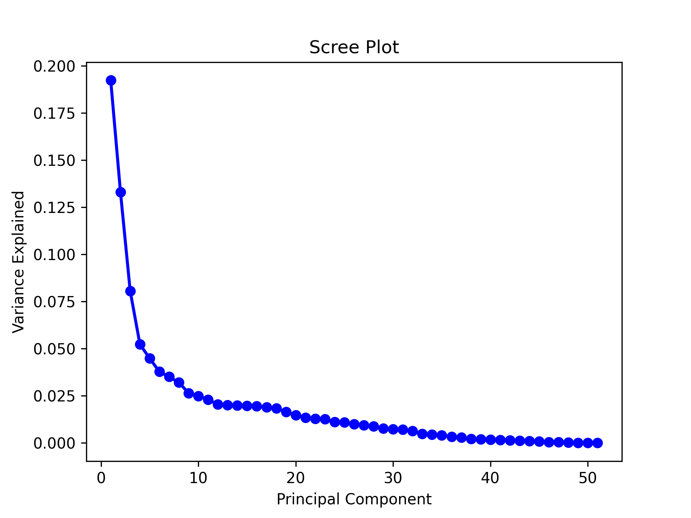
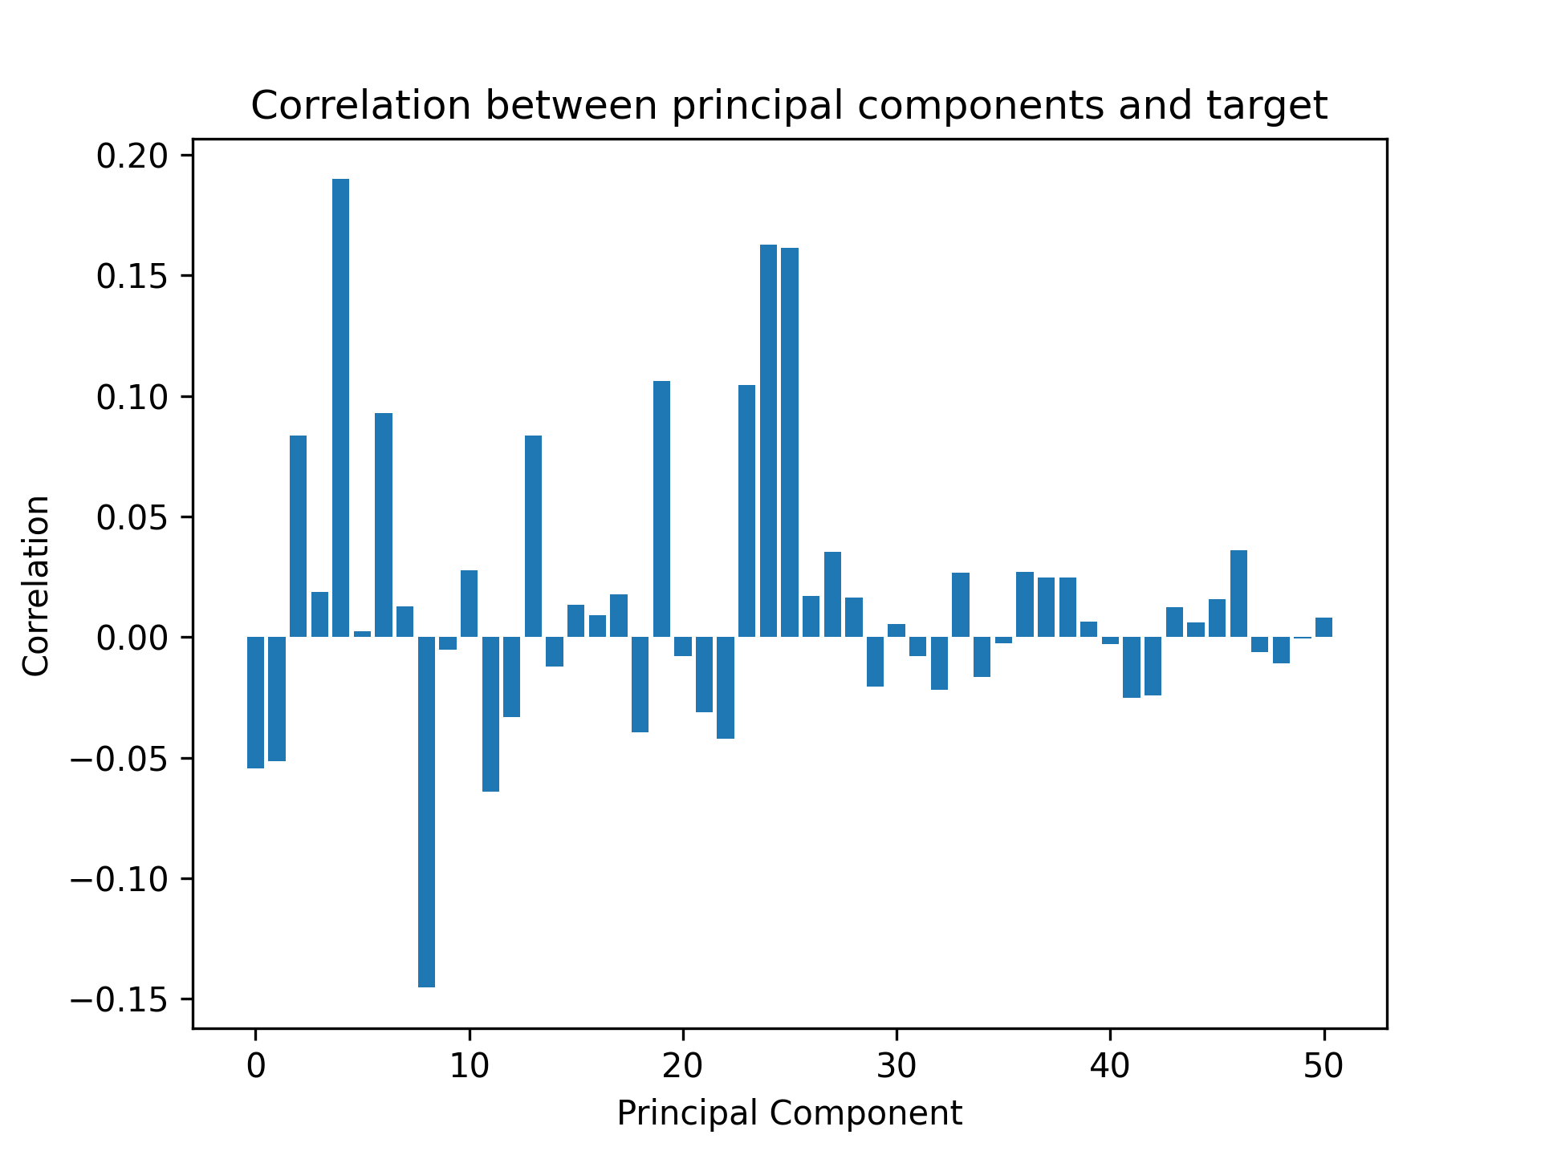
Data Check -- PCA on National Data
Table: Top 6 variables for each Principal Component:
PC | Top 1 | Top 2 | Top 3 | Top 4 | Top 5 | Top 6
1 | avg_tp | avg_e | avg_swvl1 | min_swvl1 | avg_sro | max_lai_hv
2 | avg_t2m | min_t2m | max_t2m | avg_sf | max_sf | avg_ssr
3 | avg_lai_hv | min_lai_hv | max_lai_hv | Culture/Managed | Evergreen/Deciduous Needleleaf Trees | max_ssr
4 | max_lai_l' | avg_lai_lv | min_lai_lv | Deciduous Broadleaf Trees | min_v10 | avg_v10
5 | Urban/Built | Population | PD | min_sro | min_tp | Culture/Managed
6 | max_tp | max_sro | Wetland | min_v10 | Evergreen/Deciduous Needleleaf Trees | min_u10
7 | max_sro | PD | Water | avg_sro | max_swvl1 | Wetland
Notes:
use the actual variable name
not include the implemetation
use the total 10 PC
use the font bigger.
The capacity for the random

Slide 55
Workflow
Data Check
Methodology
Preliminary Data
Future Plan

Slide 56
Methodology -- Prediction Models
Table: Results of PCA Analysis on Environmental Variables
Model | Description | Rationale for Selection | Pros | Cons
Random Forest | Ensemble learning, multiple decision trees | Robustness, handles non-linear data and missing data | Robust, handles missing values | Complex, reduced interpretability
SVM | Finds hyperplane separating classes in feature space | High-dimensional effectiveness | Performs well in high-dimensional spaces | Complex parameter tuning
Neural Network | Computing system for pattern recognition | Learns complex relationships | Exceptional pattern recognition | Proneness to overfitting, “black box”
Ensemble Model | Combines Random Forest with Autoregression | Leverages both strengths | Integrates spatial and temporal analysis | Constraints on temporal data structure
HistogramGBRT | Utilize decision trees built on a histogram-based discretization of continuous features | Efficiency, handle large datasets, regression and classification | Fast learning process, Robust, handles missing values | Complex,
SpatialGLMMs | Extend GLMs with spatially correlated random effects | Models' spatial correlation | Accurate spatial dependencies modeling | Complex interpretation
Notes:
Histogram-Based Binning is an efficient variant of gradient boosting machines (GBMs). Gradient boosting involves creating a predictive model by combining the predictions from multiple decision trees. The model starts with a base prediction (often the mean of the target variable for regression tasks) and sequentially adds new trees that predict the residuals or errors of the previous trees.
Unlike standard gradient boosting machines (GBMs) that consider every unique value when looking for the best split, HGBRT algorithms bin the continuous feature values into discrete bins, much like a histogram. This significantly reduces the number of potential splits to evaluate and speeds up the computation.
SGLMMs: Spatial Aspect: The "spatial" in SpatialGLMMs refers to the inclusion of spatial correlation among observations. This means that observations closer together are more likely to be similar than observations further apart.
SpatialGLMMs can model this with spatial random effects or by including a spatial correlation structure in the random effects.

Slide 57
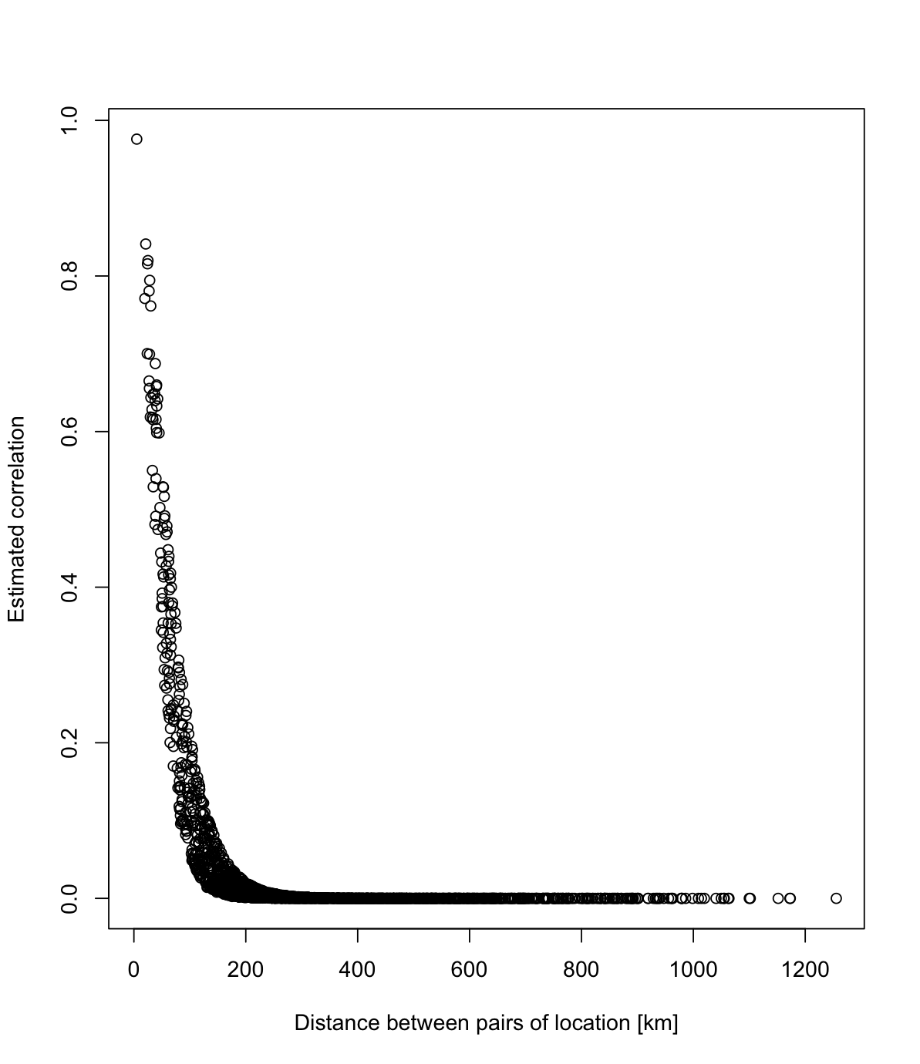
Spatial Correlation between Different County Location in California

Slide 58
Workflow
Data Check
Methodology
Preliminary Data
Future Plan

Slide 59
Preliminary Data -- Predicting National WNND
Table: Performance of Different Predict Models
Model | MSE | Q²
Linear Regression | 82.82 | 0.07
Random Forest * | 84.28 | 0.05
SVM | 80.5 | 0.09
HistogramGBRT* | 85.2 | 0.04
SGLMM ** | 92.65 | 0.015
Baseline Model *** | 88.8 | -1.05e-07
* The MSE and Q² is average results of 100 run
** Simplify the variables only use avg_src + min_ssr + Urban_Built + PD
*** Always predict mean value

Slide 60
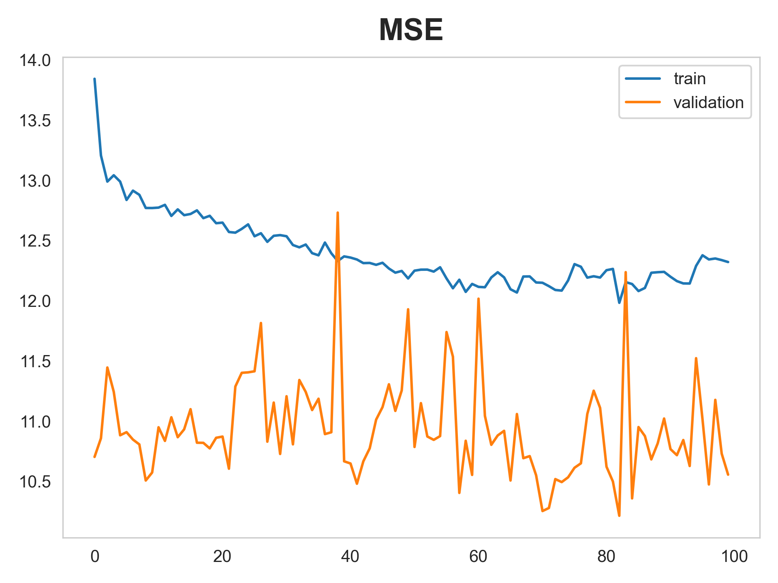
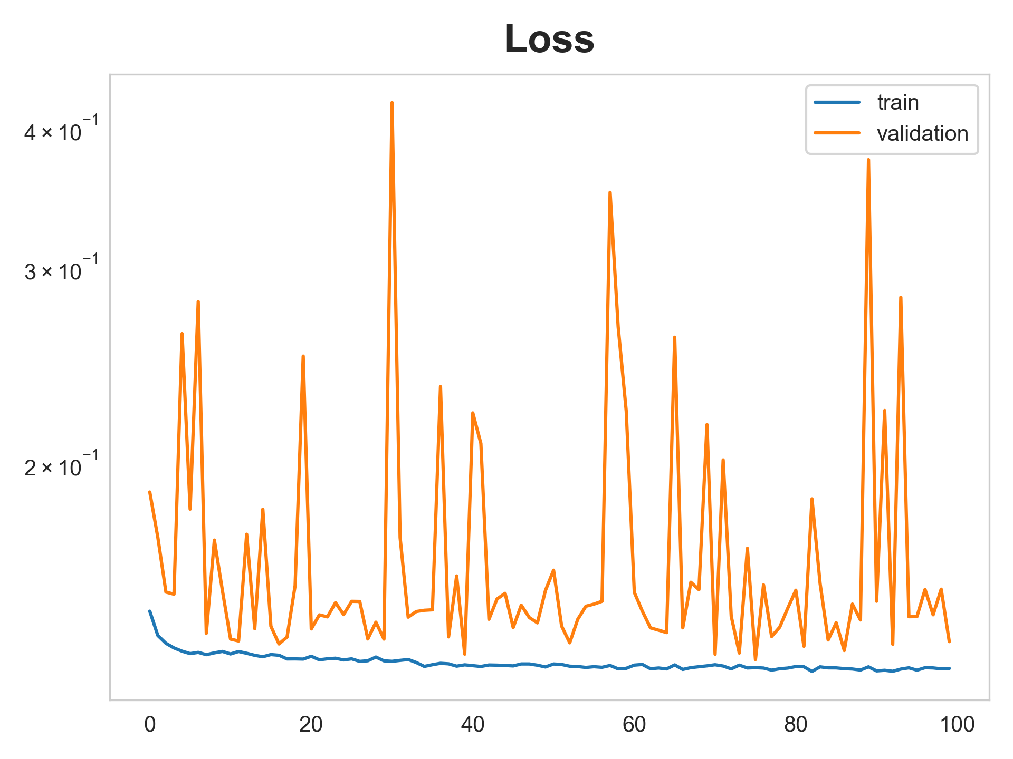
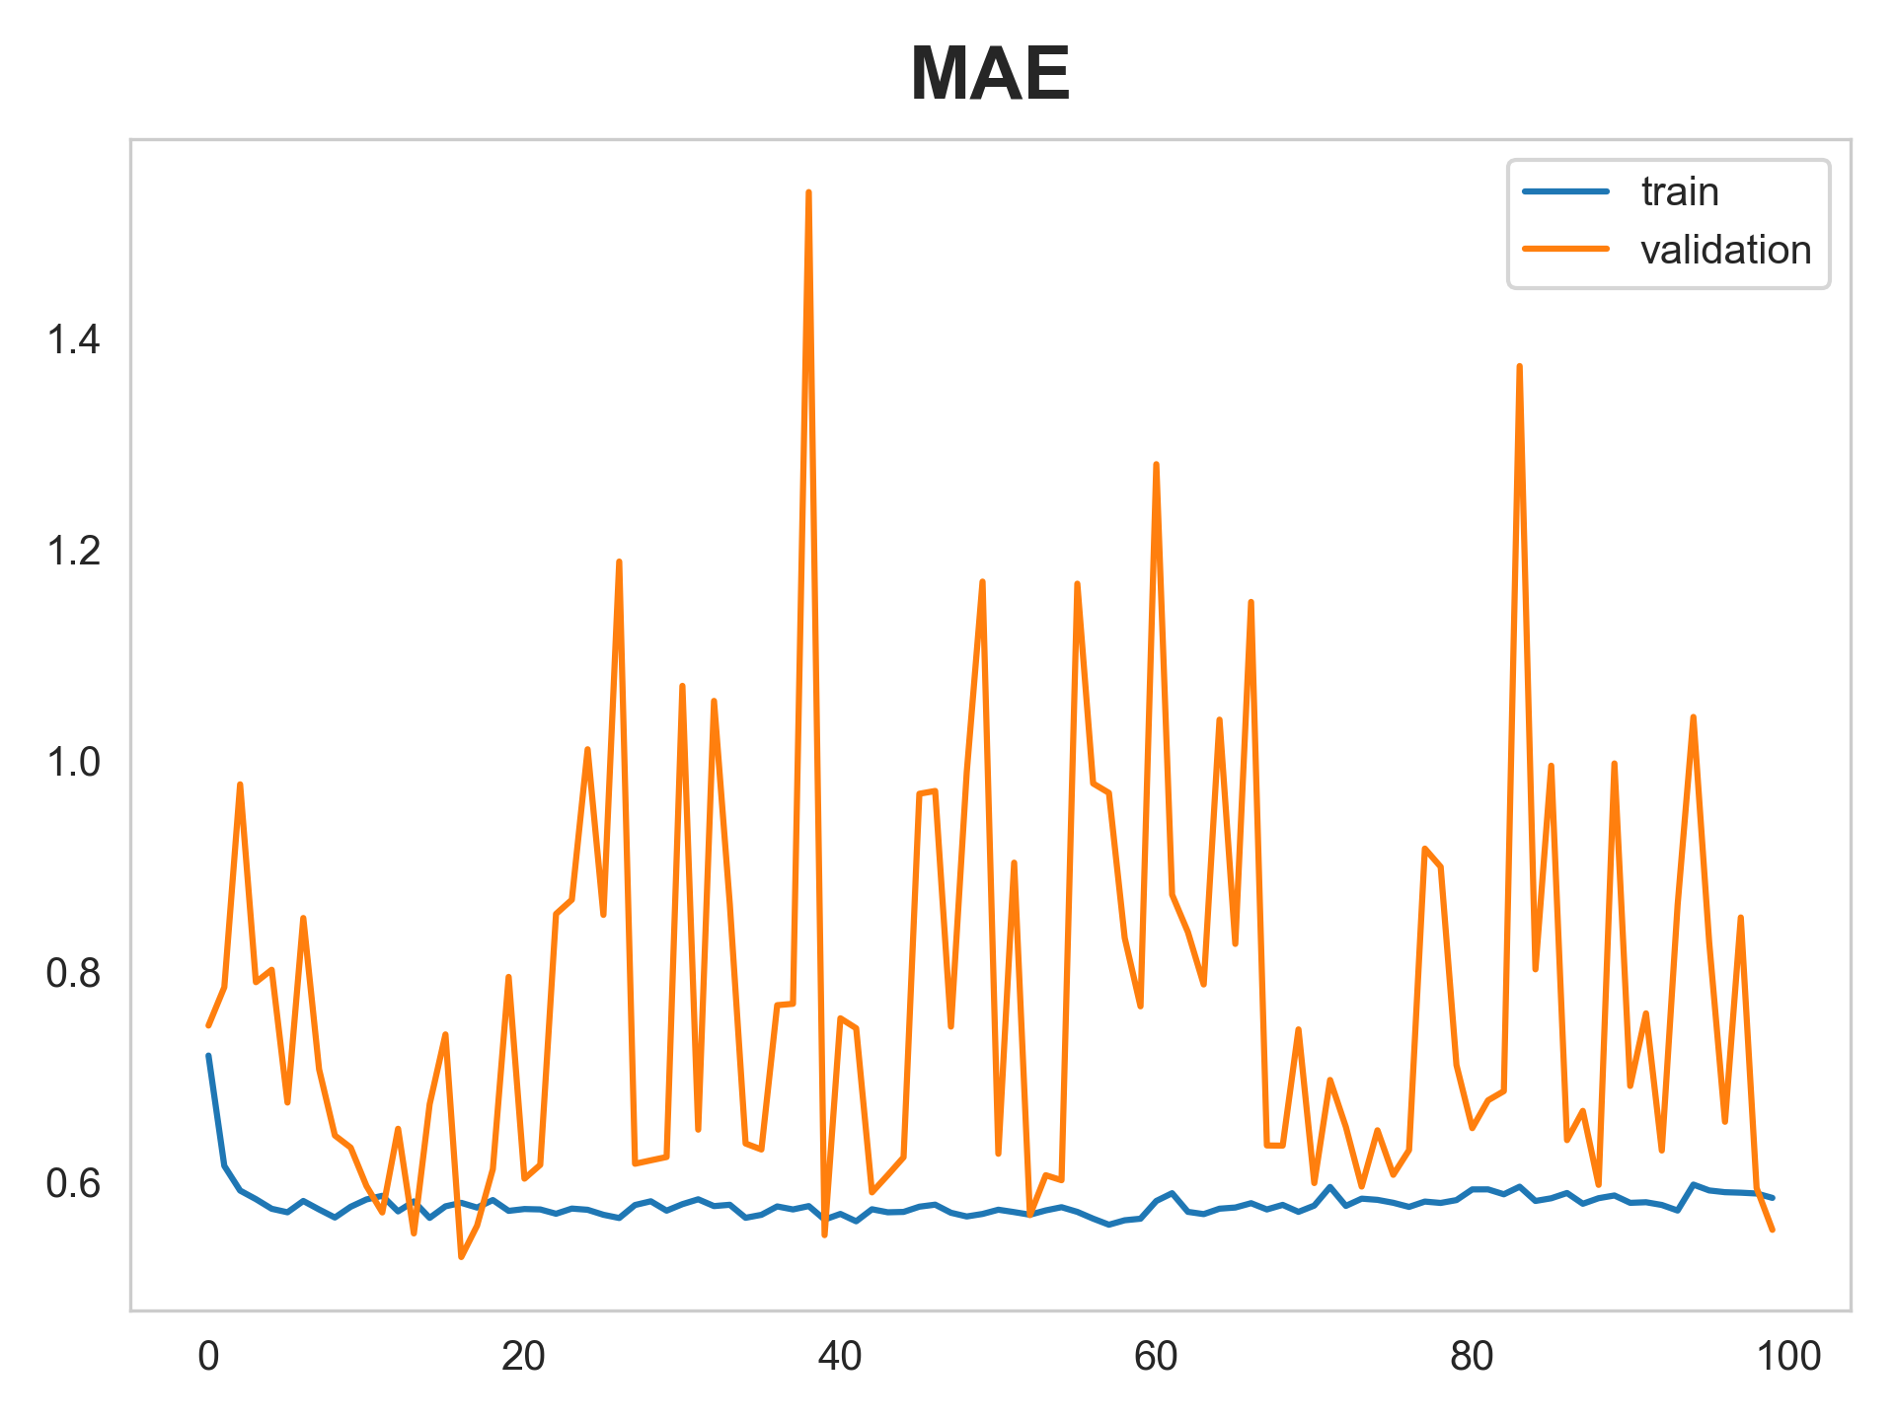
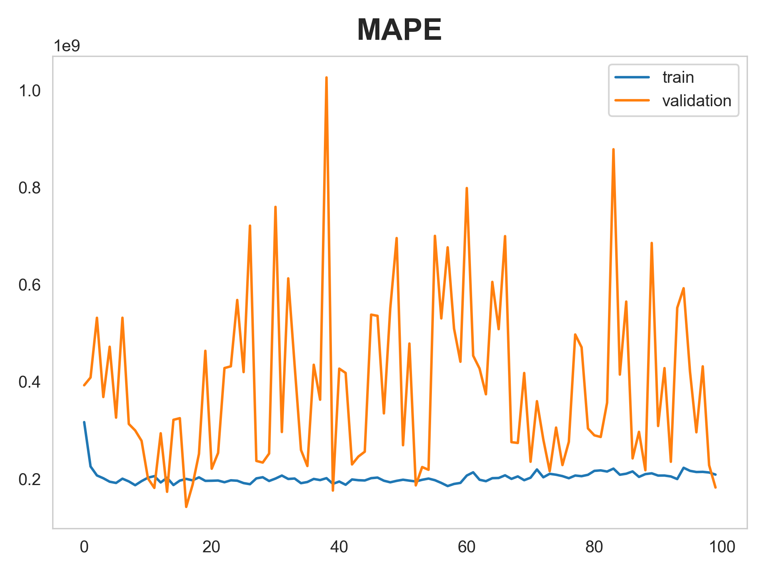
Neural Network Results
Msle:
Mse:
Mae:
Mean Absolute Percentage Error (Mape):

Slide 61

Preliminary Data – Predicting National WNND with PCA
Table: Performance of Different Predict Models with the first 5 PCs of PCA
Model | MSE | Q²
Linear Regression | 97.01 | 0.02
Random Forest* | 84.11 | 0.05
SVM | 85.40 | 0.04
HistogramGBRT* | 83.39 | 0.06
What are the issues?
* The MSE and Q² for RF is average results of 100 run

Slide 62
Preliminary Data – Challenges
Inconsistency in Data Collection
Significant Class Imbalance
Data Granularity in Human Data
…

Slide 63
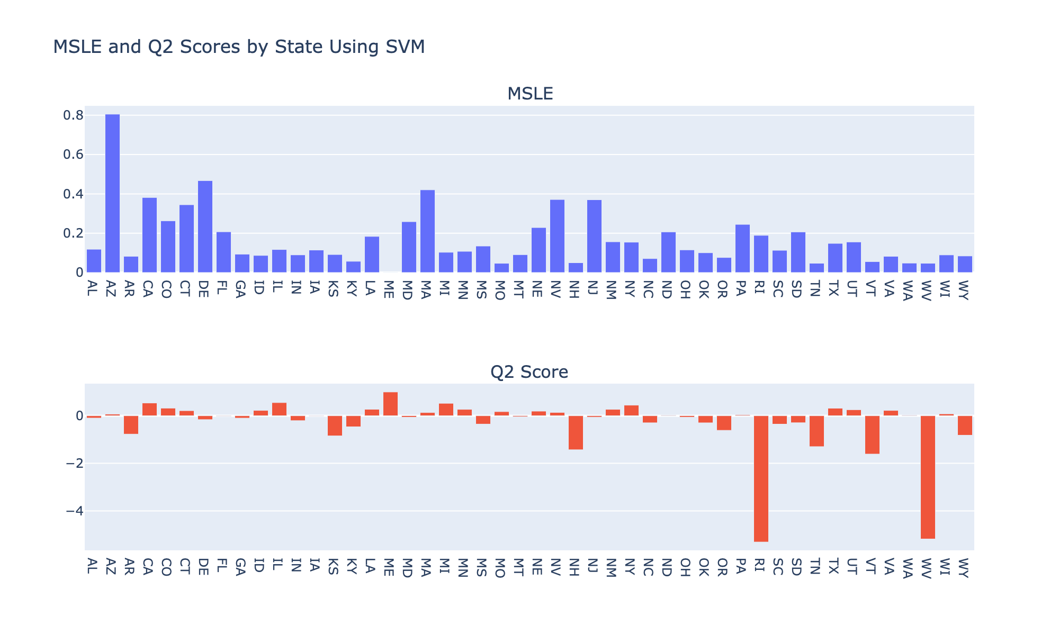
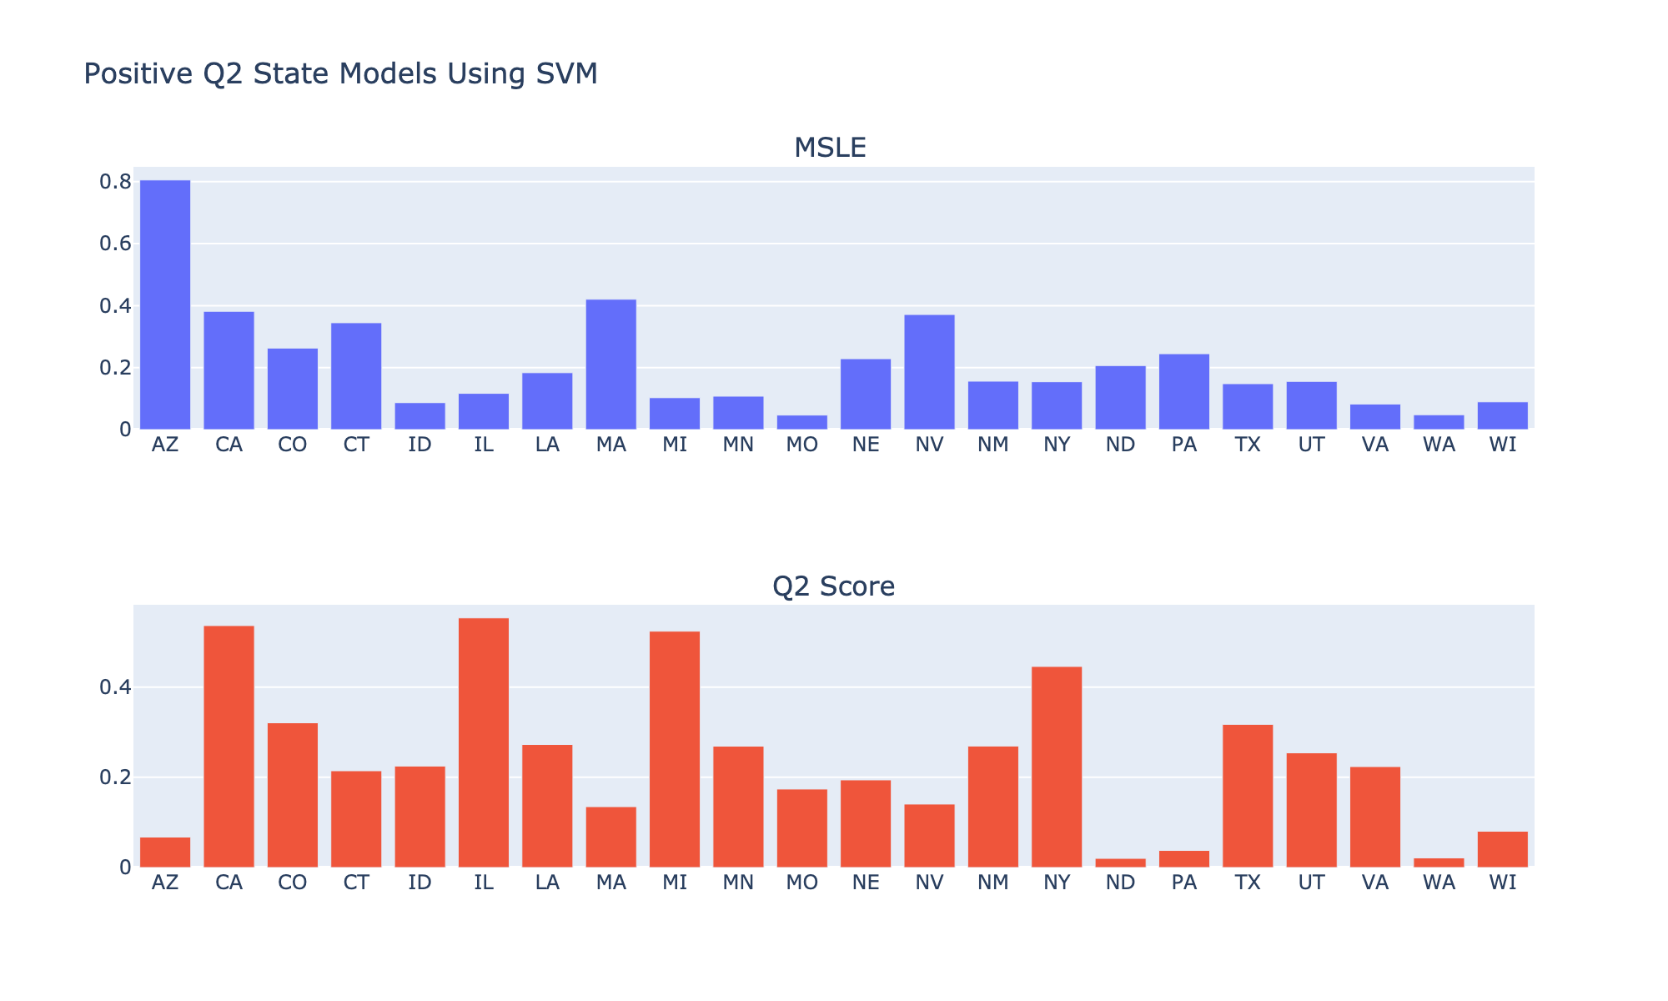
National Modeling for Each State Cases
Same national data
Change from modeling the whole nation to modeling on each state

Slide 64
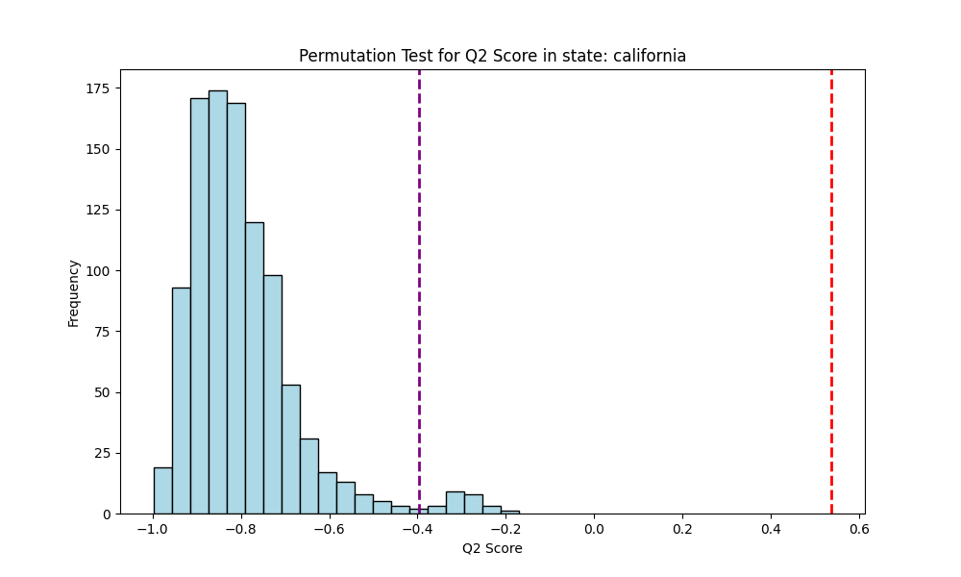
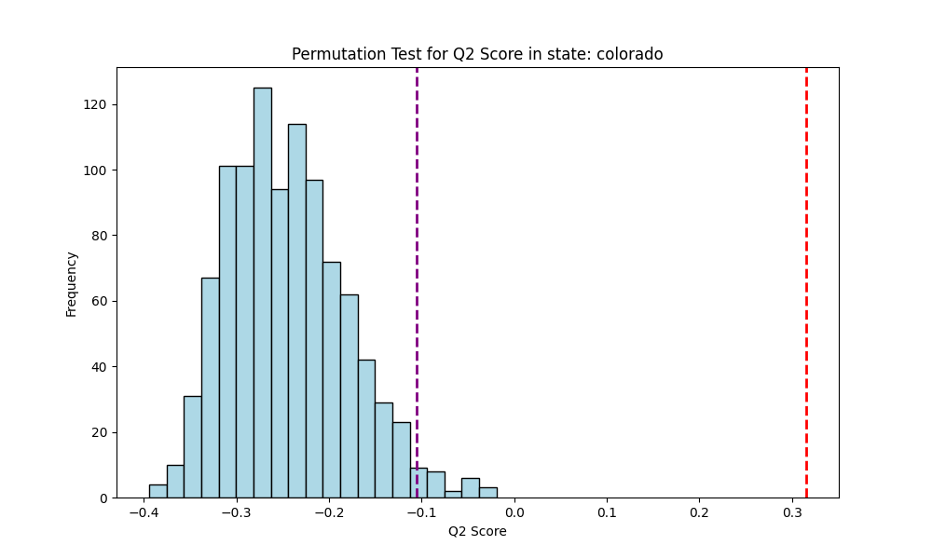
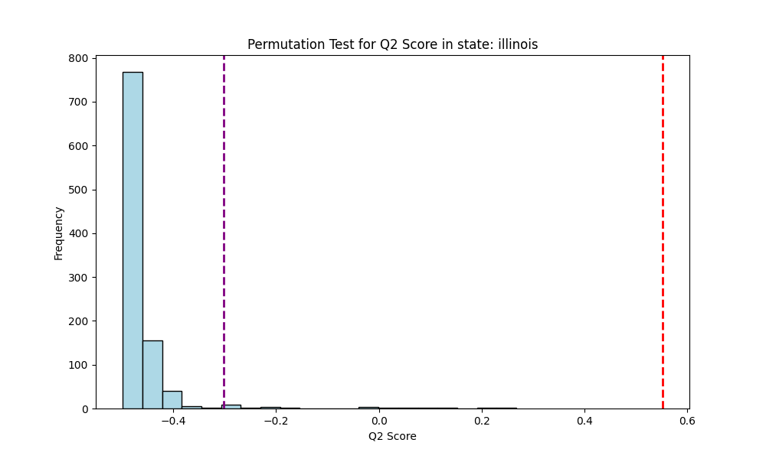
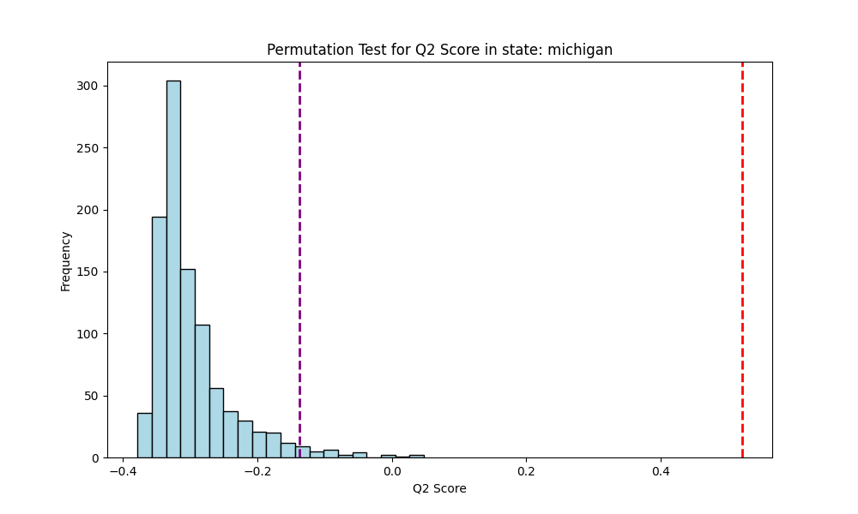
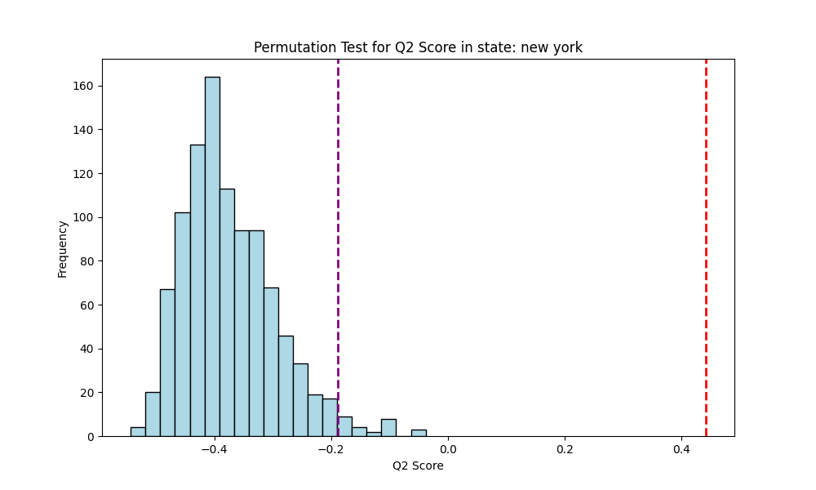
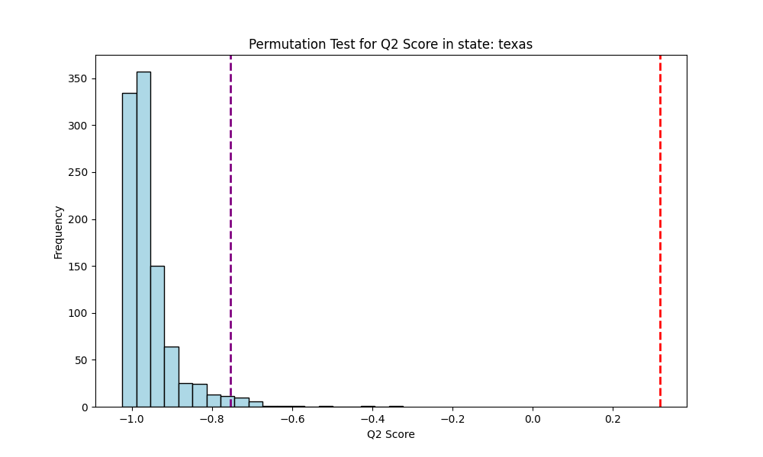
Permutation Test on Each State SVM Model
Figure: Permutation test (1,000 iterations),
Purple dashed line represents the 97.5% percentile Q²,
Red dashed line represents the previous observed Q² trained on original dataset
Notes:
The fact that your observed Q2 (0.5) is substantially higher (better) than the 97.5% percentile of the permuted Q2 scores (-0.4) indicates that the predictive accuracy of your model is significantly better than what would be expected if there were no true relationship between the predictors and the response variable. Essentially, it suggests that the association captured by your model is unlikely to have occurred by chance.

Slide 65
WNV Binary Prediction – All Organisms
Tables. Maximize F1 score by changing probability threshold to determine 0 and 1 using SVM for different states
State | Threshold | F1 | Accuracy | AUC-ROC
New York | 0.58 | 0.694 | 0.846 | 0.82
California | 0.86 | 0.862 | 0.835 | 0.87
Illinois | 0 | 0.552 | 0.381 | 0.60
Michigan | 0.2 | 0.546 | 0.404 | 0.65
National | 0.3 | 0.496 | 0.748 | 0.74
Because national data contains
a lot of missing Values
Notes:
Accuracy is a straightforward measure of overall correctness but can be misleading for imbalanced datasets.
F1 Score provides a more nuanced view, especially useful when precision and recall are equally important or when dealing with imbalanced data. It helps to understand the model's performance in terms of both the completeness (recall) and the purity (precision) of the positive predictions it makes.
SVM probability issue??

Slide 66
Preliminary Data – Challenges
Inconsistency in Data Collection
Significant Class Imbalance
Data Granularity in Human Data
…

Slide 67


Imbalance Issue – CDC Annual Human
Total 49140 rows of data

Slide 68
Subsampling – National Model Annual WNND
Use subsampling to down-sample majority class (0 cases) for both national and individual state
Original results for national disease count performance
Resampling results for national disease count performance
Model | MSE | Q²
Linear Regression | 82.82 | 0.07
Random Forest* | 84.28 | 0.05
HistogramGBRT* | 85.2 | 0.04
SVM | 80.5 | 0.09
Baseline Model ** | 88.8 | -1.05e-07
Model | MSE | Q²
Linear Regression | 314.90 | 0.08
Random Forest* | 325.12 | 0.05
HistogramGBRT* | 311.34 | 0.09
SVM | 309 | 0.09
* The MSE and Q² is average results of 100 run
** Always predict mean value
Notes:
use the point to talk about the summary
Baseline mmodel
to change the ** to different color.
adding slide number for people to refer.

Slide 69


Subsampling – State Model Annual WNND
Original results for each state model with Pos. Q²
Subsampling results for each state model with Pos. Q²

Slide 70
Preliminary Data – Challenges
Inconsistency in Data Collection
Significant Class Imbalance
Data Granularity in Human Data
…

Slide 71
County-Monthly Granularity Data - CA
Figure: Kendall’s Test Correlation Heatmap on California Monthly county level WNND Count
Notes:
Big point on each slide
add one slide about which variables for general audians
BIg font
to extract rth einformarion for ageneral udience
minimum the slides. and zoom in.
remember to breath.

Slide 72
County-Monthly Granularity Data - CA
Figure: Kendall’s Test Pvalue Heatmap on California Monthly county level WNND Count

Slide 73




Predict California WNND Cases
(A)
(B)
(C)
(D)
Figure: (A) and (B) are MSE and Q2 of running Ensemble, RF, Linear Regression and SVM 1000 times.
(C) and (D) are MSE and Q2 Permutation Test on RF with 1000 iterations, the dotted red line are 0.025 and 0.975 Percentile

Slide 74
Other Works Has Done
Predict disease incidence
Predict non-human cases (birds, mosquitoes, horses)
Try different environmental variable with past.

Slide 75
Summary
Challenges in WNV Modeling:
Inconsistent data collection across regions.
Significant class imbalance leading to skewed models favoring zero-case predictions.
Strategic Adjustments:
Implemented subsampling techniques to address class imbalance.
Shifted focus to binary classification for more reliable predictions.
Focus on States with Robust Reporting: New York, California, Illinois and Michigan.
Enhanced Model Performance:
Binary classification demonstrated greater effectiveness than numerical case predictions.
Improved model accuracy with detailed monthly data analysis, particularly in California.

Slide 76

Future Plans
Prompt engineering using LLM (Llama 2 or gemma) to extract total human disease (WNND + WNF + blood donation) from the California Weekly dataset from 2004 to 2023, total 766 PDF files.
Working on modeling the new California Dataset
Try new prediction such as risk level, predict worse or better for the new month.
Figuring out the best way to handle the results we had for both national and state models. In a literature publication or project report for USDA collaborators.

Slide 77

Project Timeline

Slide 78



